Slide 1
Game Design

Slide 2
Hi I’m John!

Slide 3

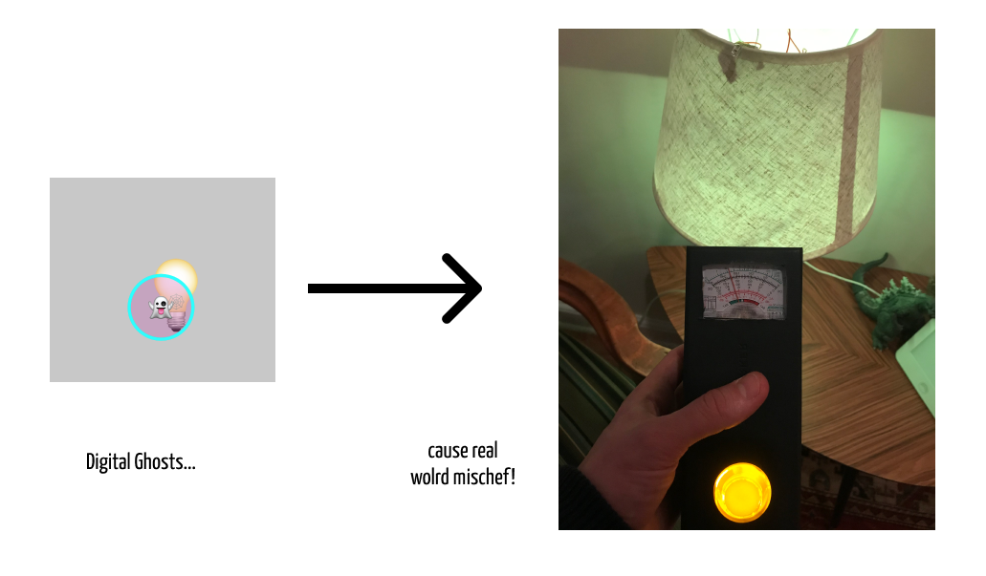
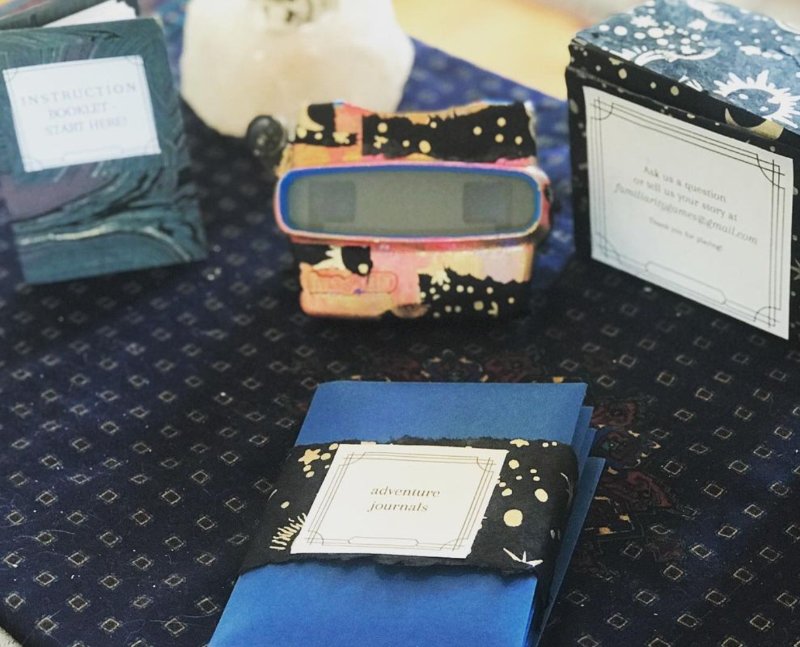
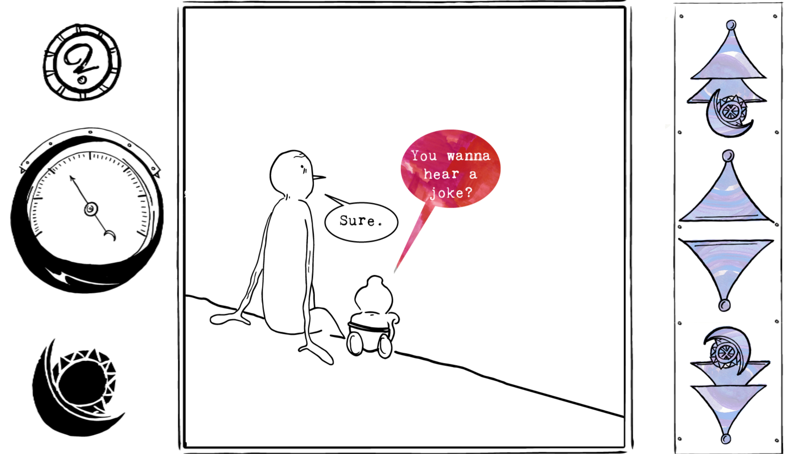
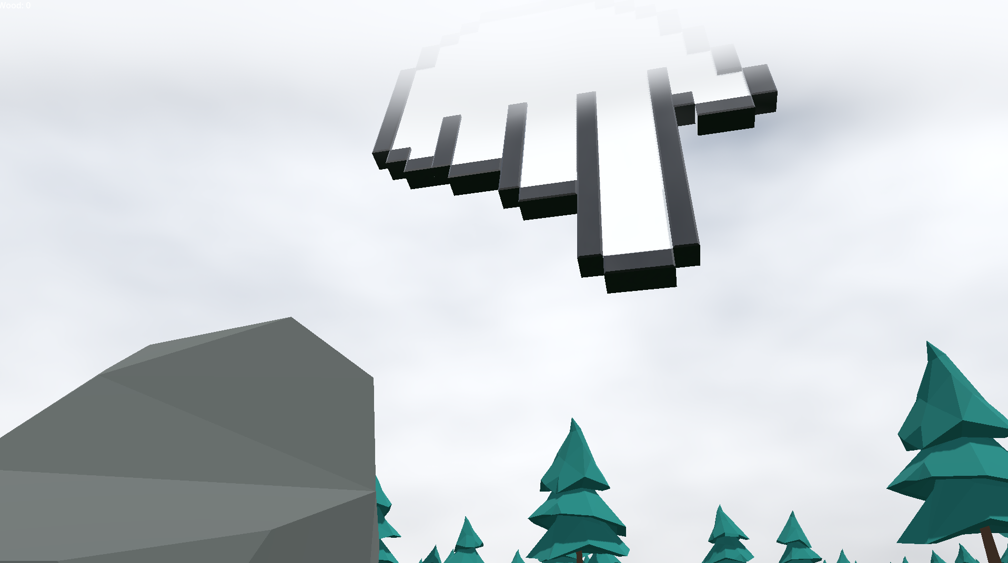
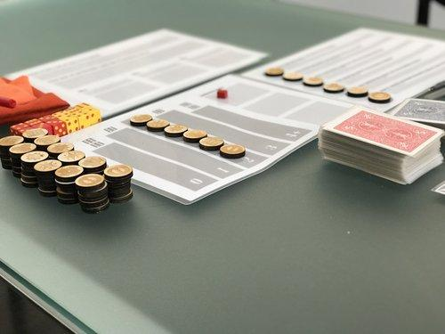
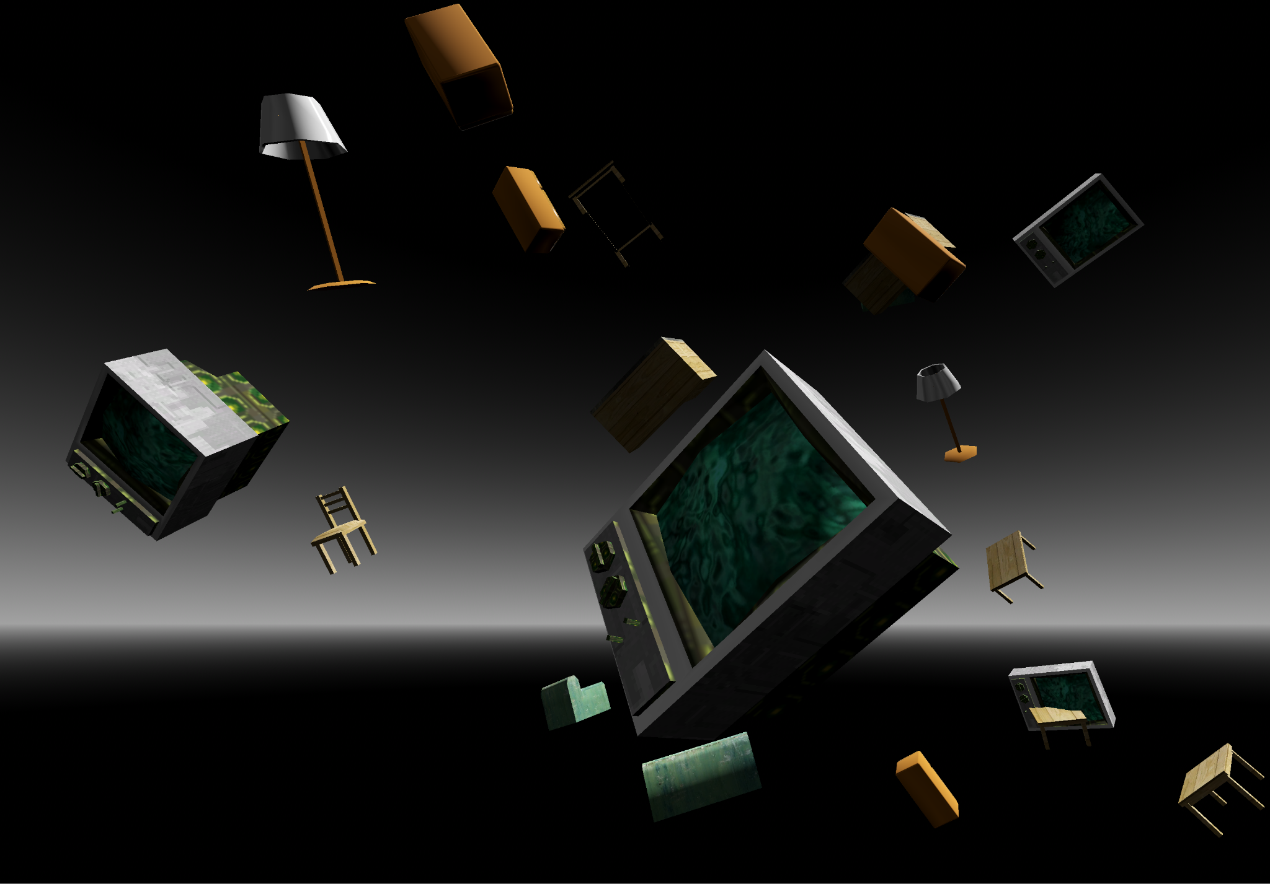
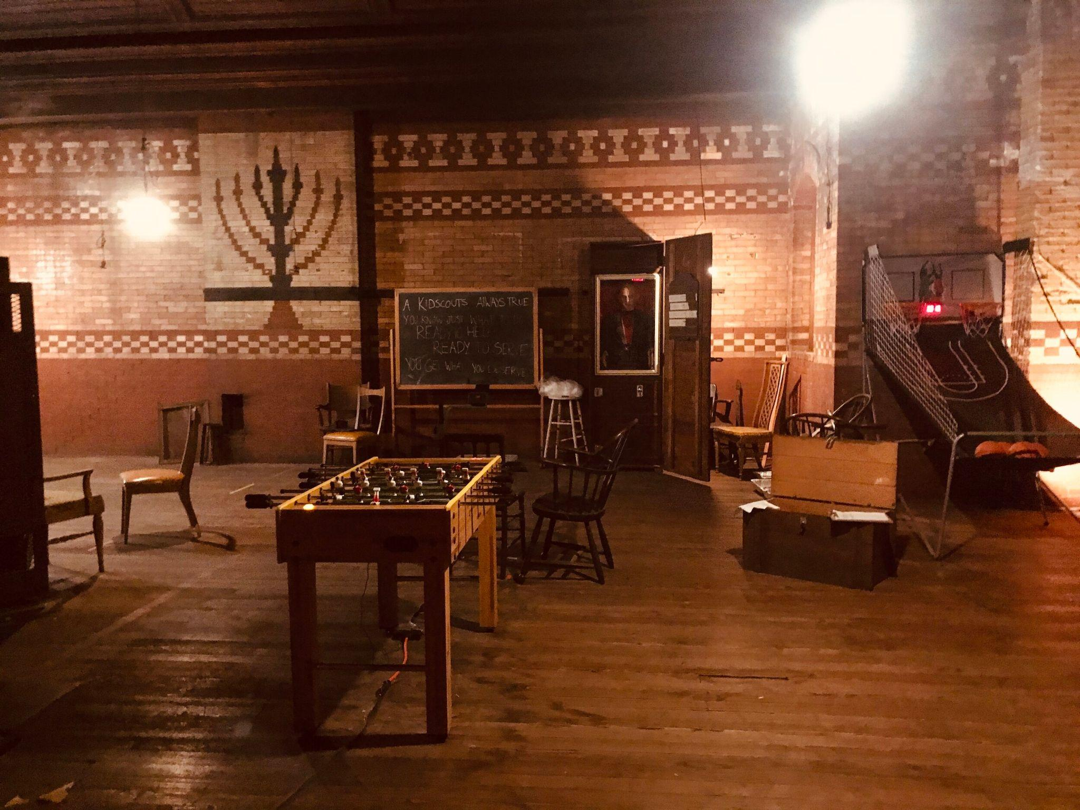
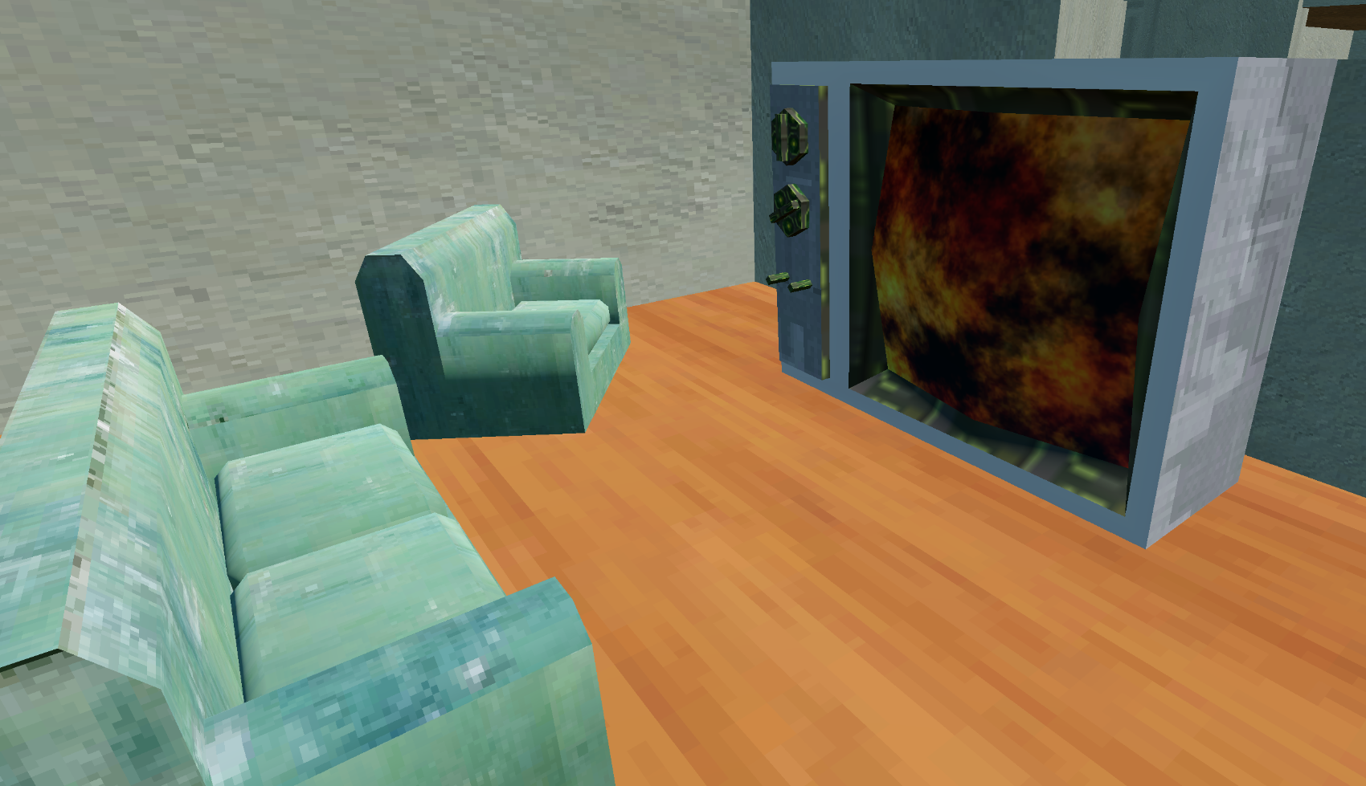
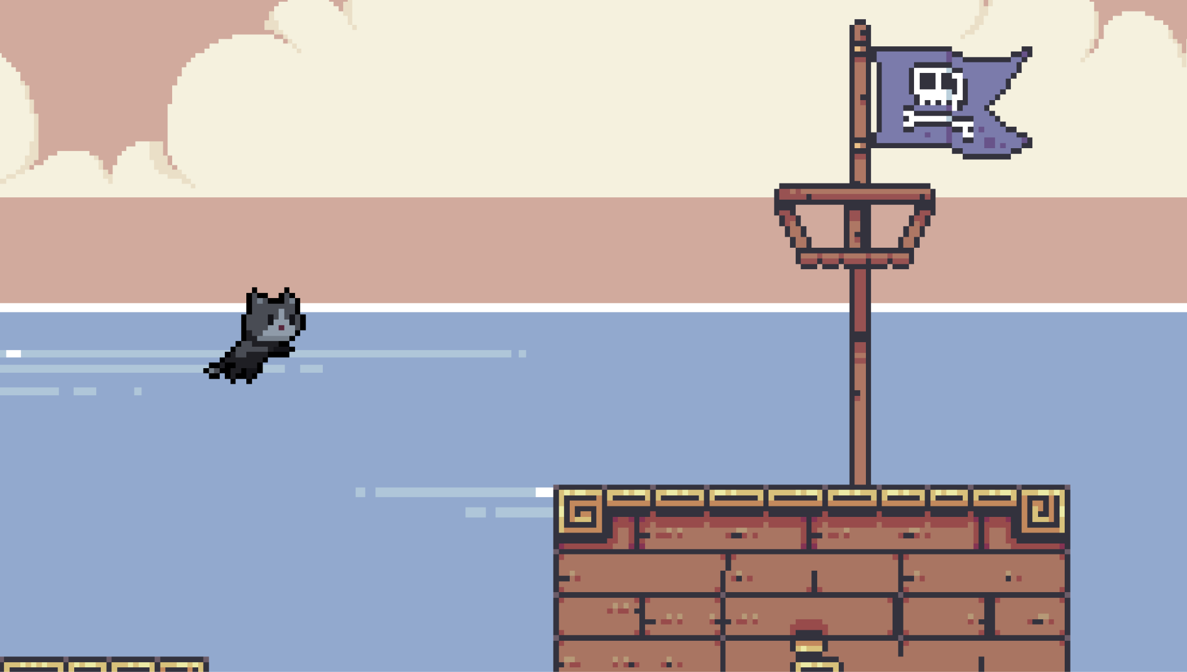

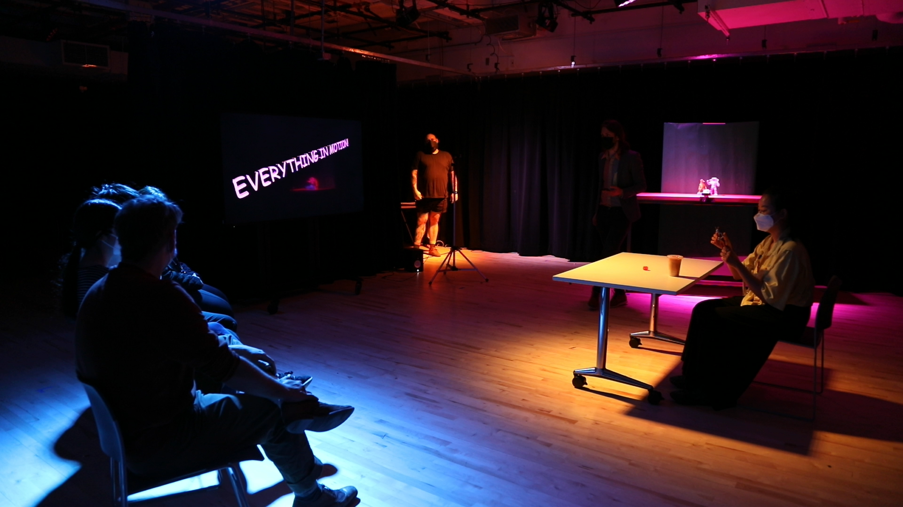
I’m John
Notes:
My name is John Bezark and I’m a game designer.
I’ve designed a lot of different games. I’ve made
-2D Games
-3D Games
-Board Games
Card Games
Game Shows
Escape Rooms
Role Playing Games
I’ve even made a sport
I’ve made games in every dimension!

Slide 4
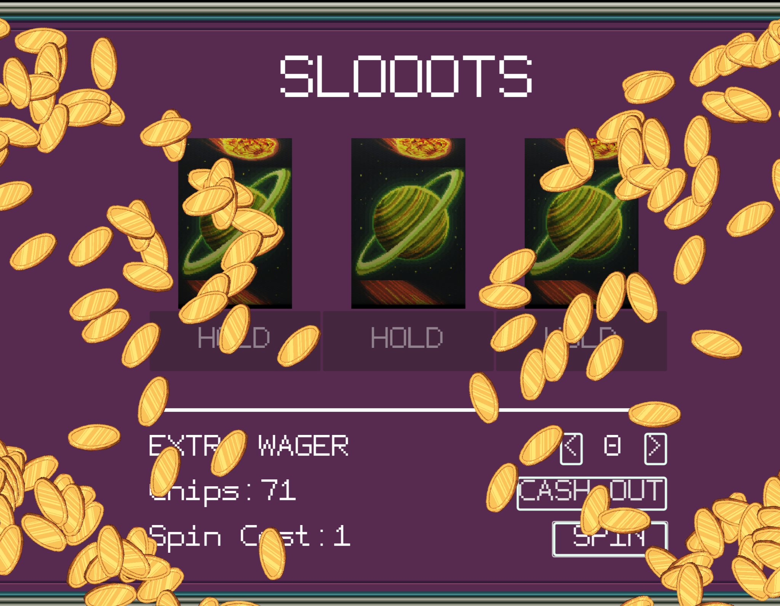
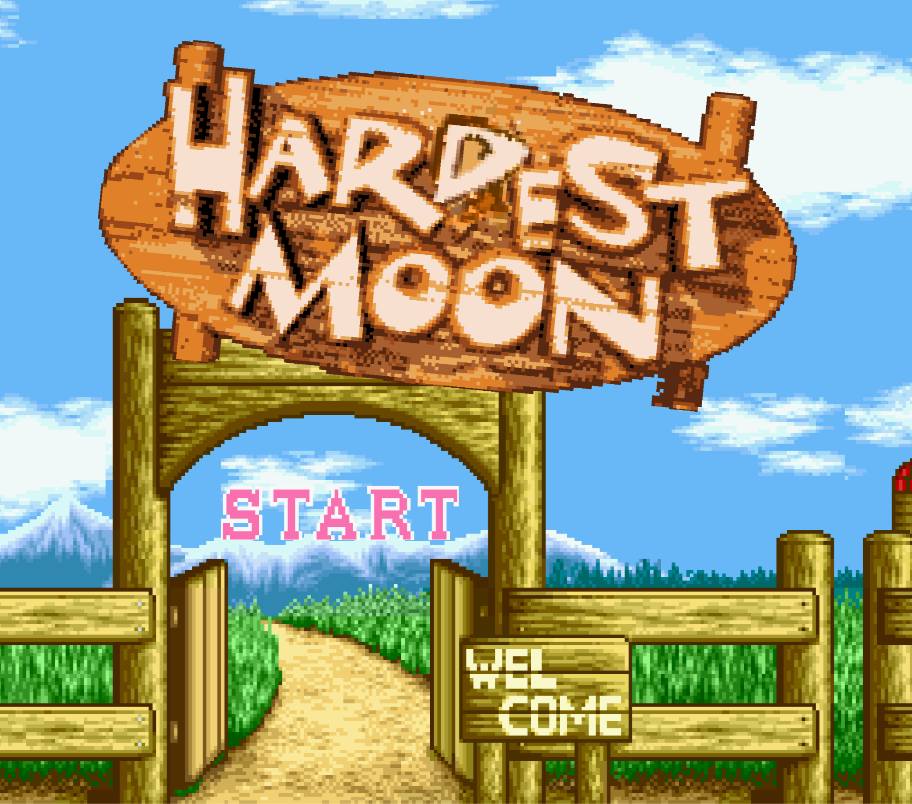
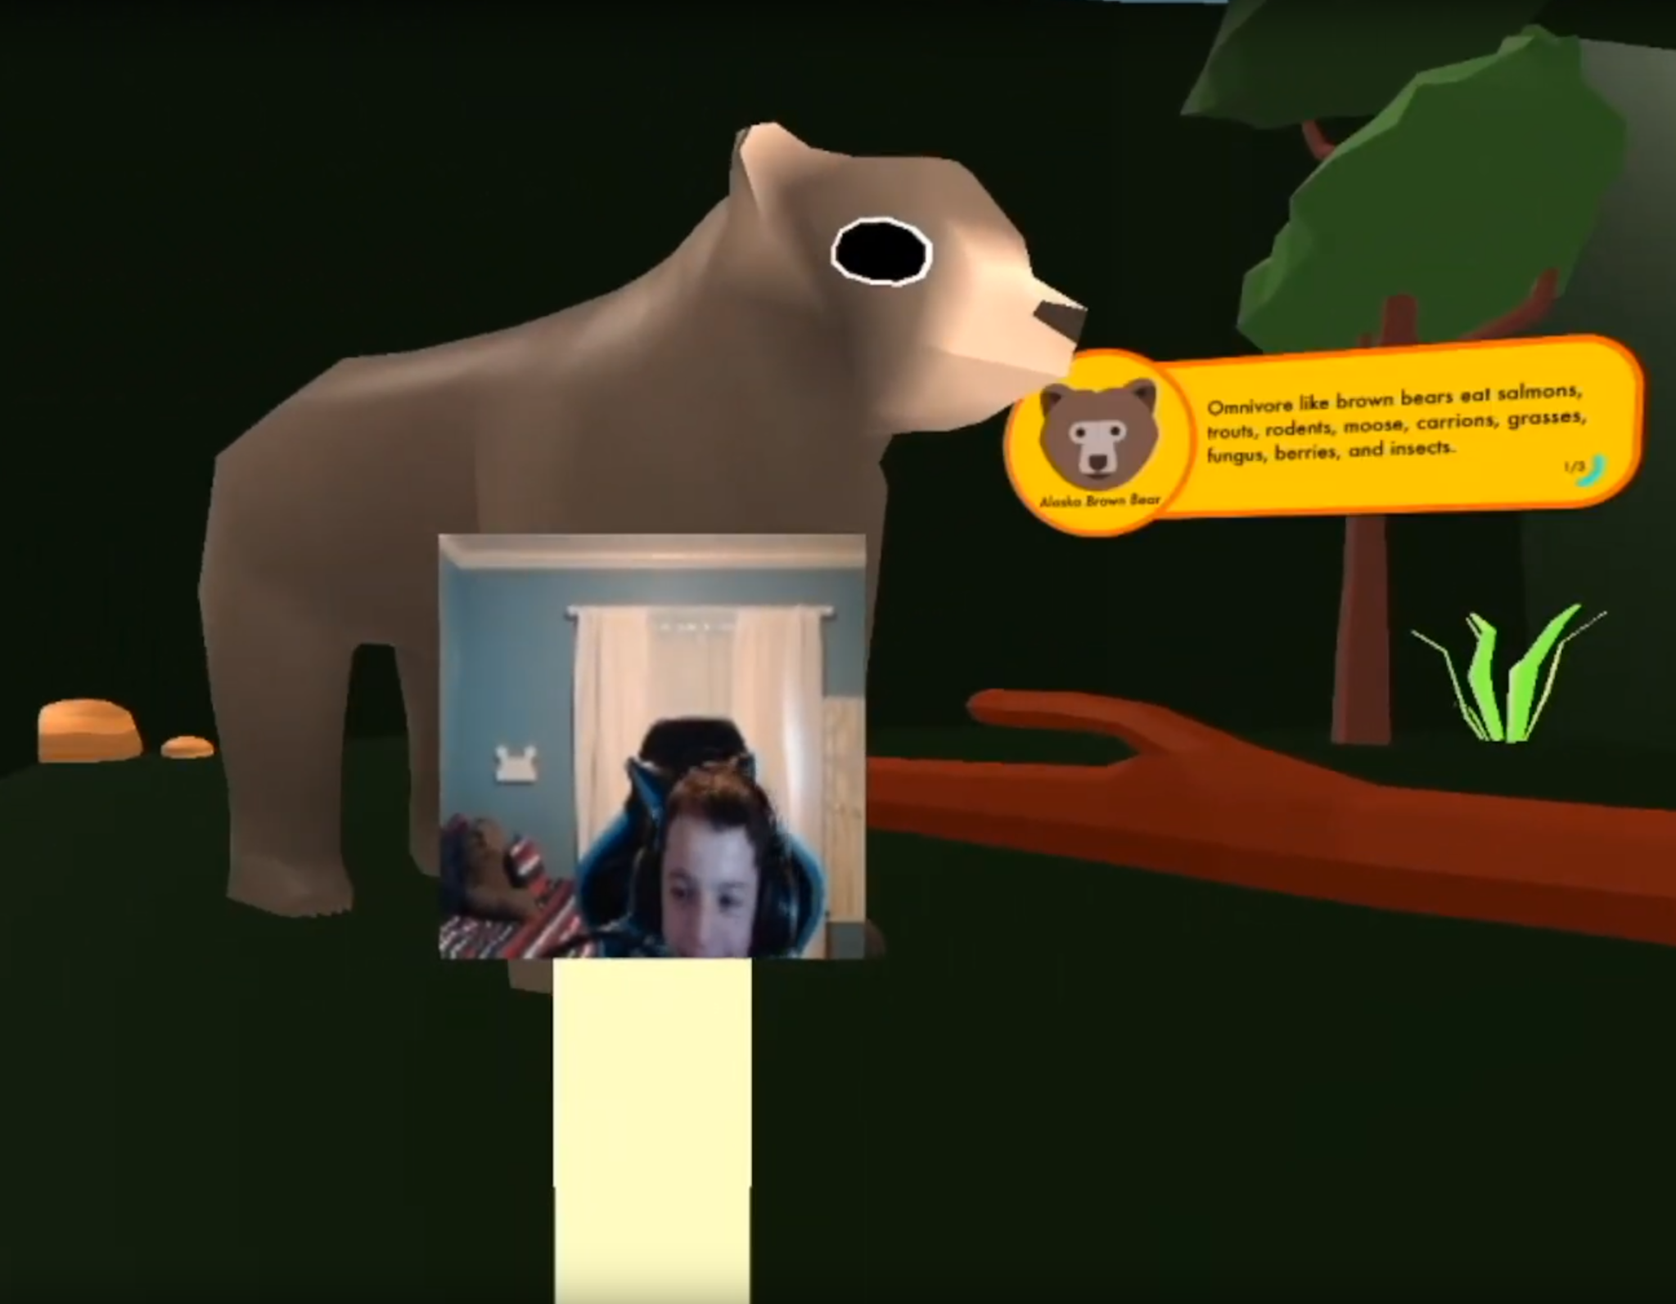
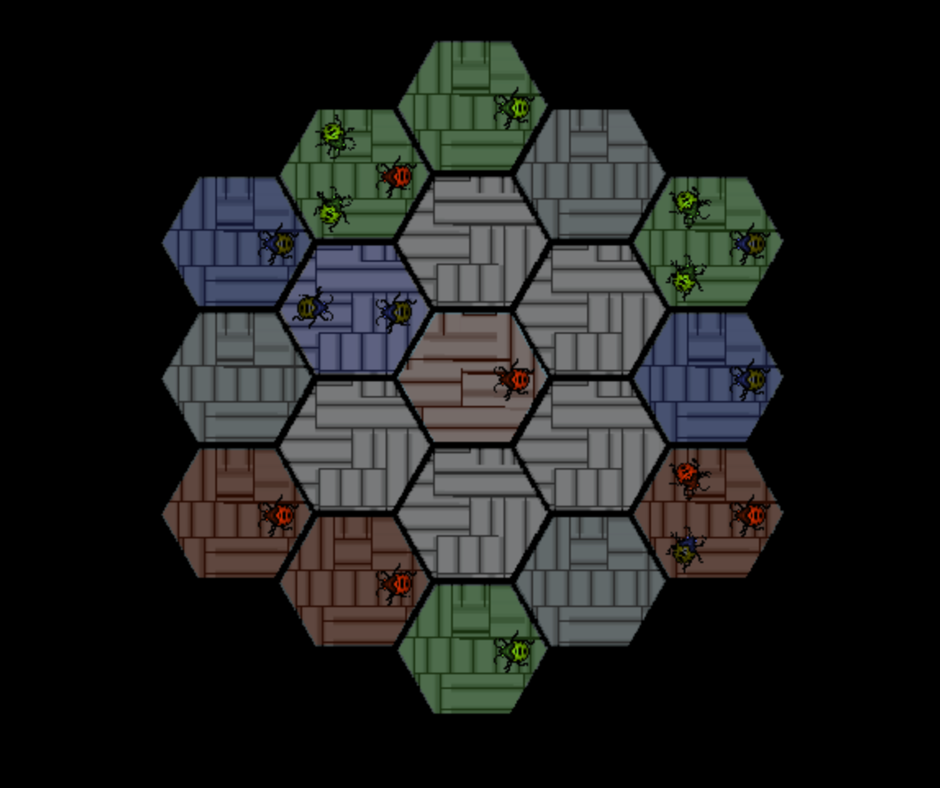
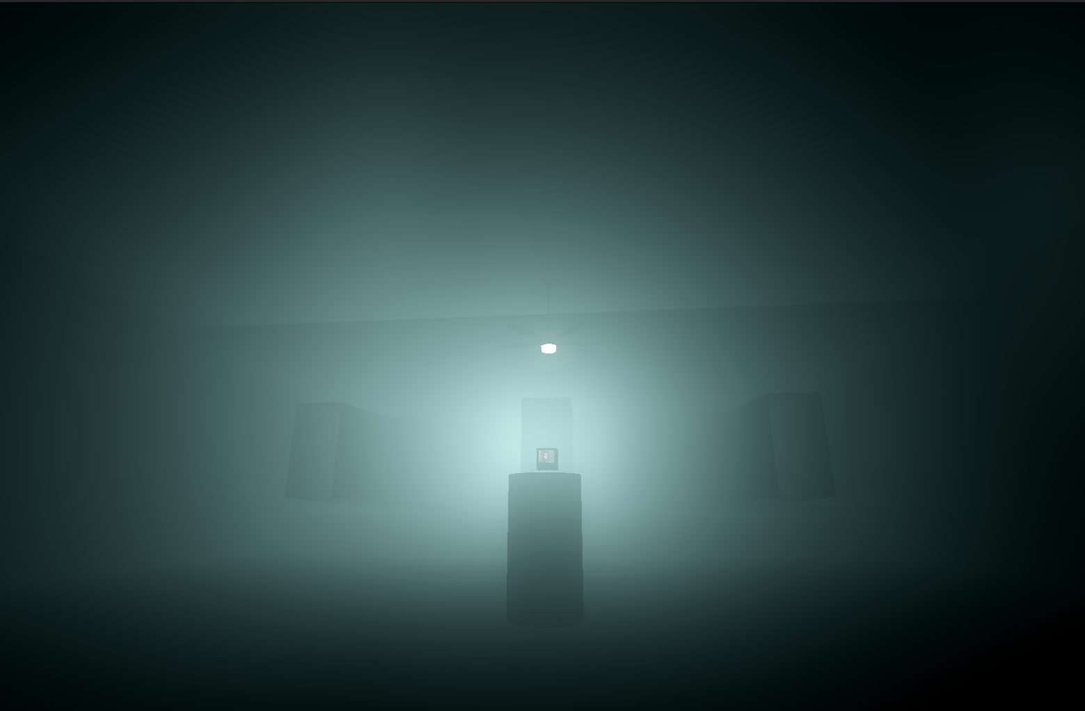
I make Video Games…

Slide 5
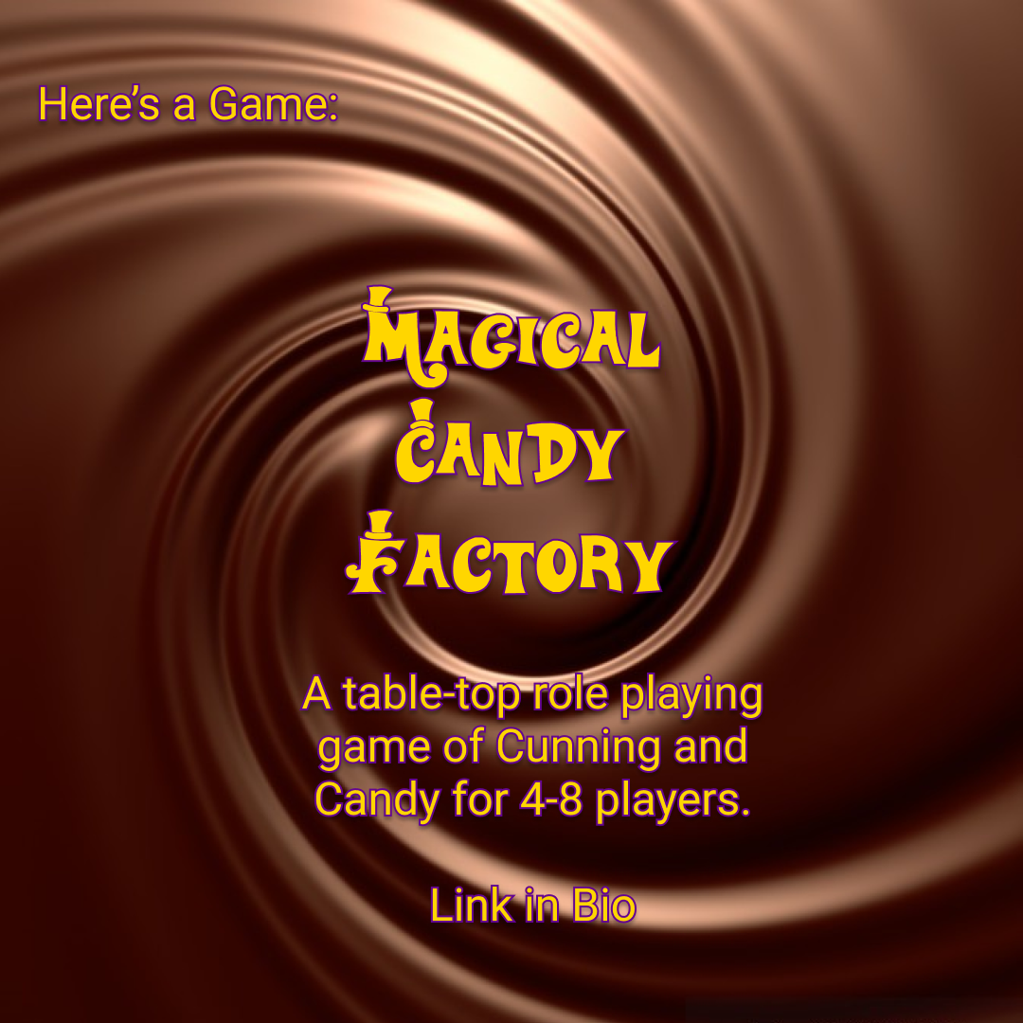
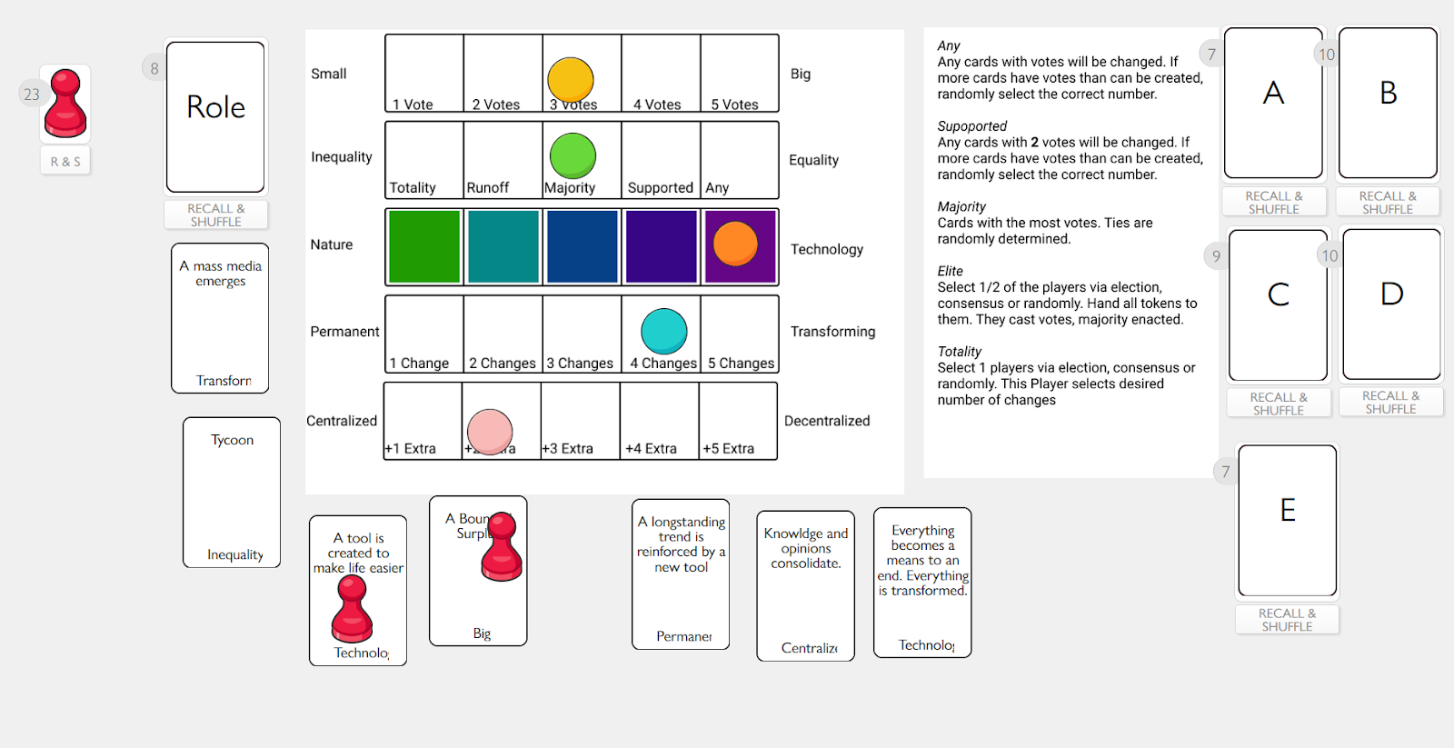
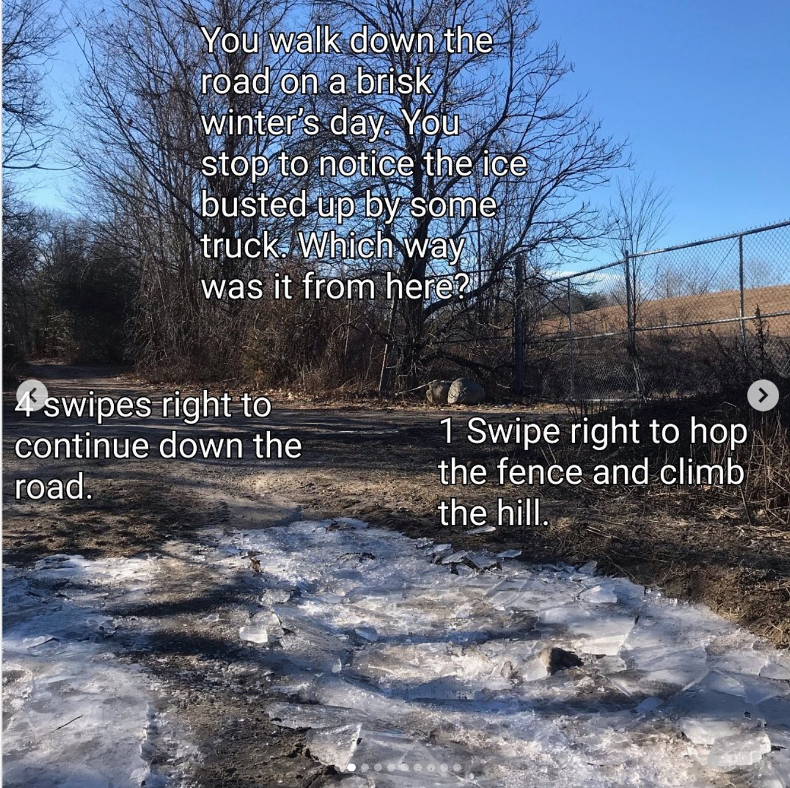
Tabletop Games…

Slide 6

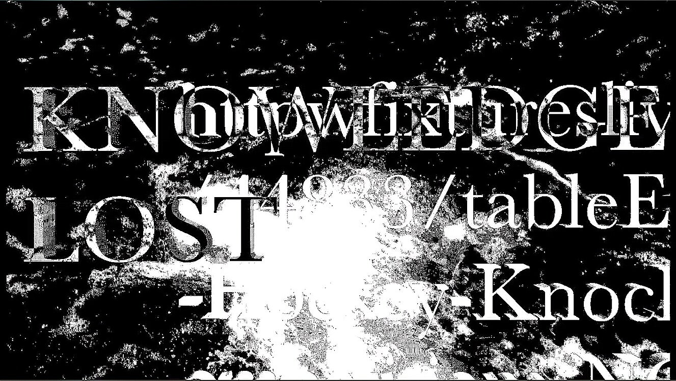

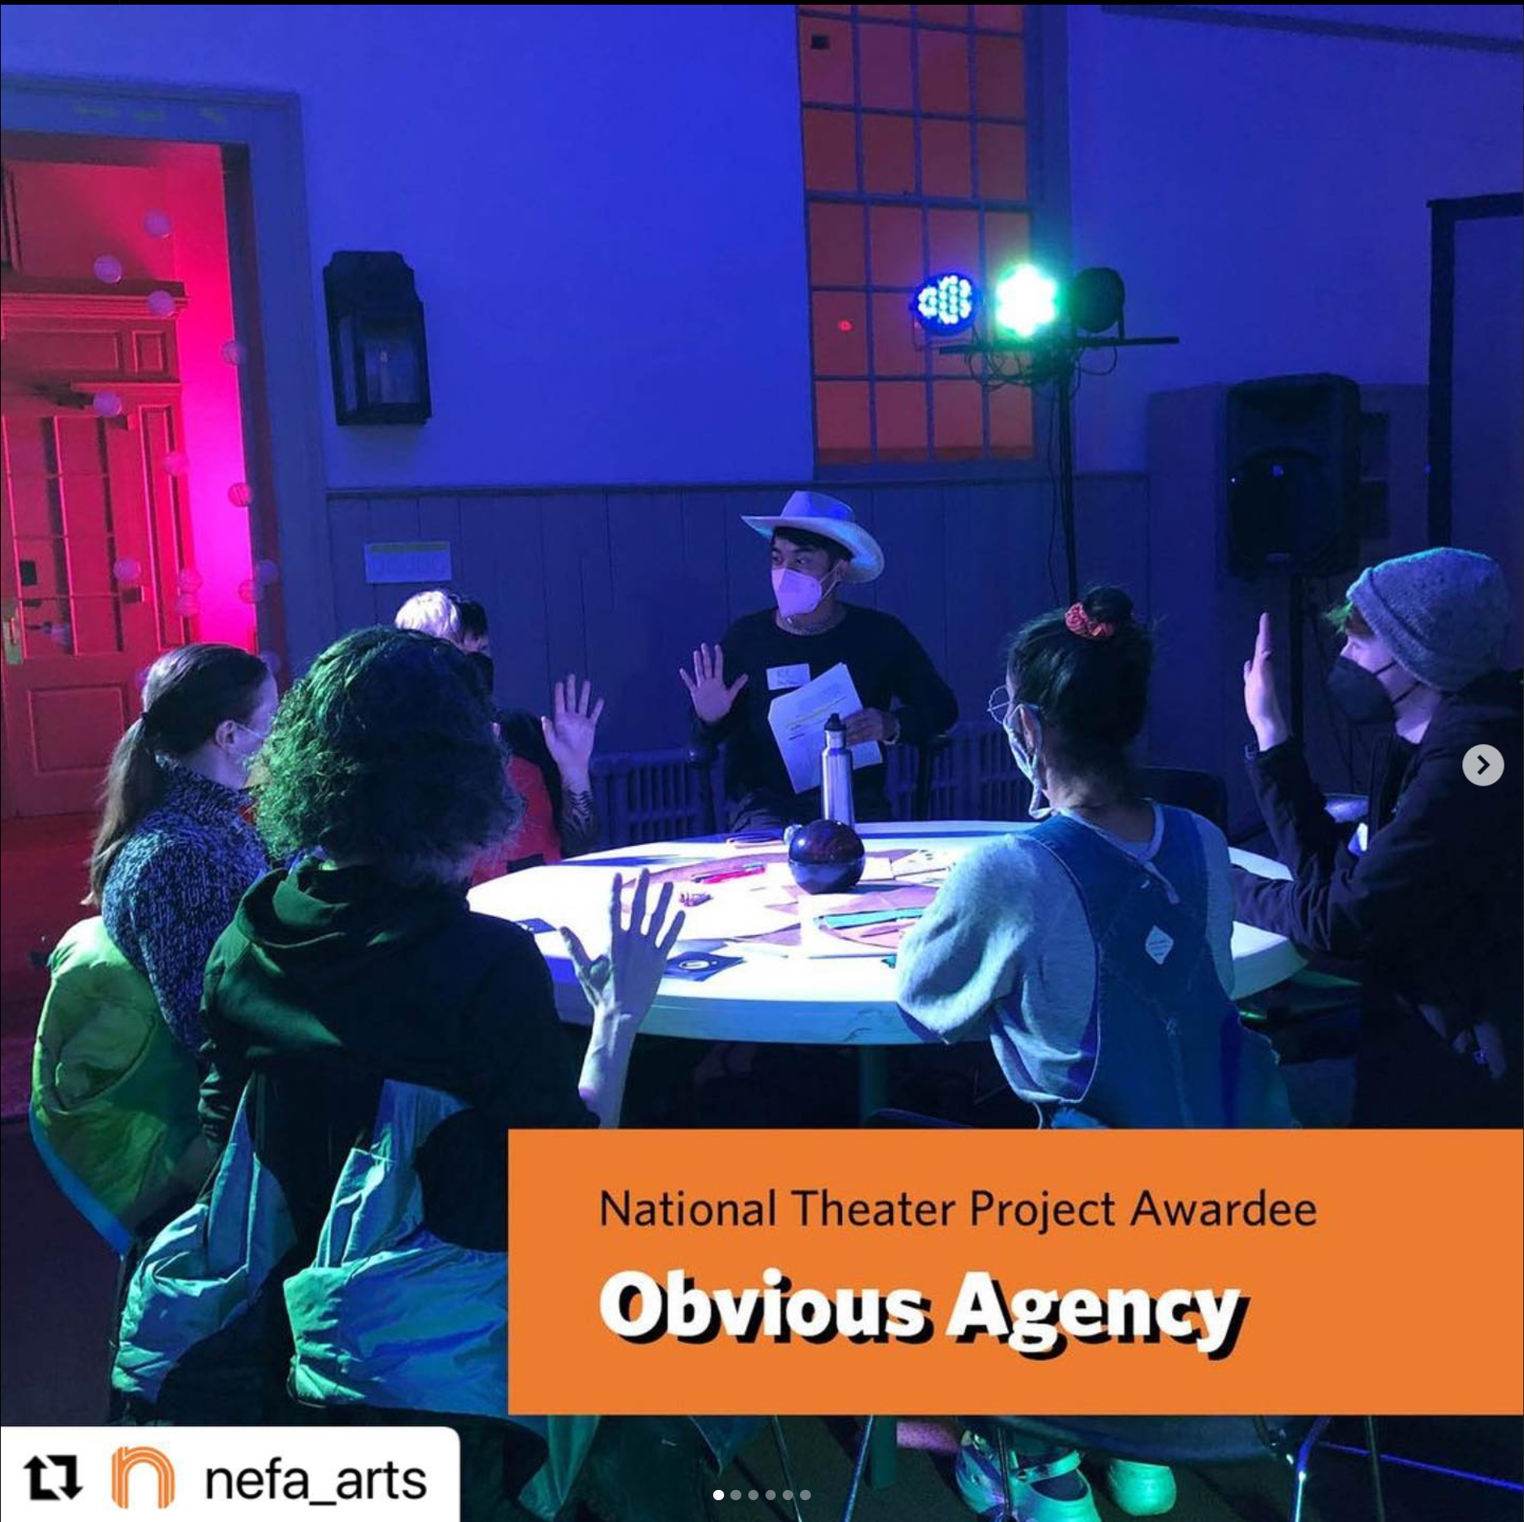
and Immersive Experiences

Slide 7
What is Game Design?

Slide 8
What is a Game?
Notes:
~10 mins in

Slide 9


Slide 10


Slide 11


Slide 12


Slide 13


Slide 14


Slide 15
“Voluntary effort to overcome unnecessary
obstacles.”
Bernard Suits

Slide 16
Games need
OBSTACLES

Slide 17
Games need
RULES

Slide 18
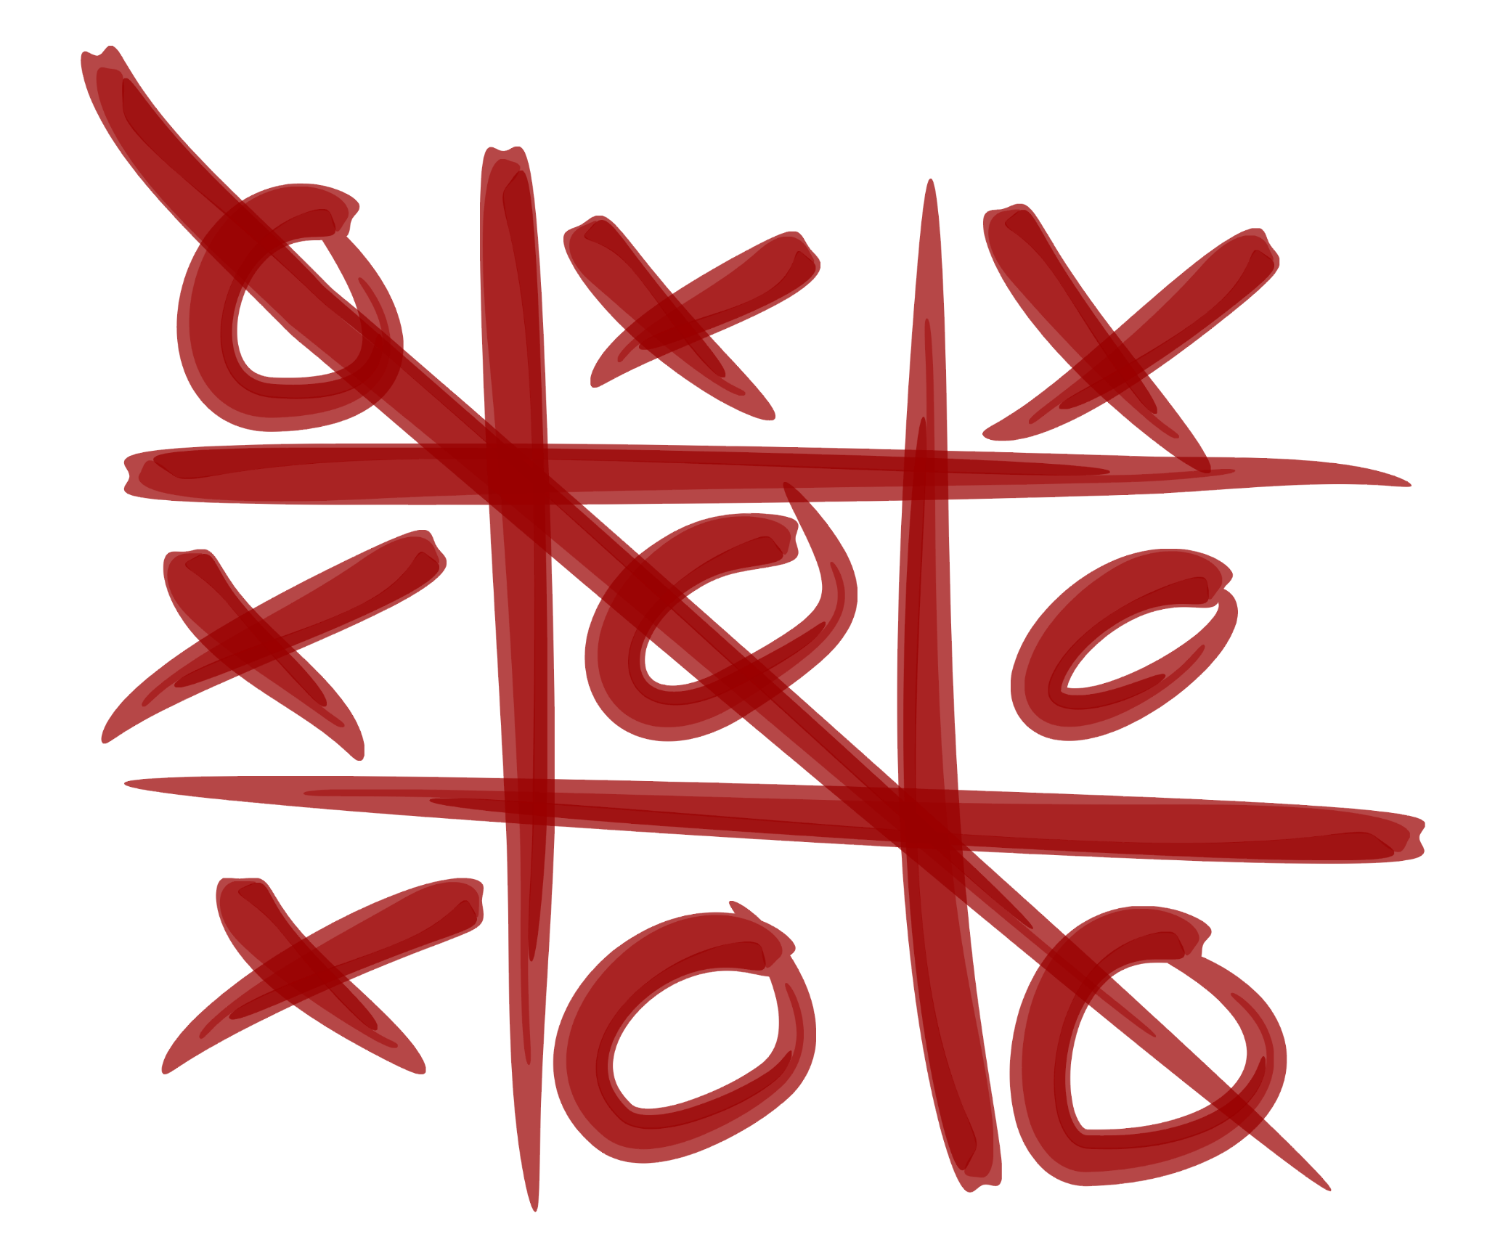

Slide 19
Tic Tac Toe Rules
Draw a 3x3 Grid. One player plays as “X”, the other “O”.
Players take turns putting their marks in empty squares.
The first player to get 3 of her marks in a row (up, down, across, or diagonally) is the winner.
When all 9 squares are full, the game is over.
If no player has 3 marks in a row, the game ends in a tie.

Slide 20
What is Game Design?

Slide 21
What is Game Design?
Making Rules

Slide 22
Rules = Mechanics

Slide 23
The Magic Circle
“All play moves and has its being within a playground… The arena, the card-table, the magic circle, the temple, the stage, the screen, the tennis court, the court of justice, etc, are all in form and function playgrounds, i.e. forbidden spots, isolated, hedged round, hallowed, within which special rules obtain. All are temporary worlds within the ordinary world, dedicated to the performance of an act apart.”
Notes:
Huizinga is probably best known for calling out that play takes place in a separate space: “the arena, the card-table, the magic circle, the temple, the stage, the screen…” (p. 10). This has been condensed in recent times to the idea of the magic circle: whether a game has anything to do with magic or not, it takes place in a separate space and time set aside for it, “within which special rules obtain” (p. 10).
Sellers, Michael. Advanced Game Design (p. 171). Pearson Education. Kindle Edition.

Slide 24
M.D.A. Framework
Mechanics
↓
Dynamics
↓
Aesthetics
Notes:
Mechanics describes the particular components of the game, at the level of data representation and algorithms.
Dynamics describes the run-time behavior of the mechanics acting on player inputs and each other’s outputs over time.
Aesthetics describes the desirable emotional responses evoked in the players when they interact with the game system.
Sellers, Michael. Advanced Game Design (pp. 175-176).
A key point of this framework is that players typically understand a game from its aesthetics first, then the game’s dynamics, and finally its mechanics. The MDA framework posits that in contrast to players, game designers see their games first via their mechanics, then the dynamics, and finally the aesthetics.
Another important point inherent in the MDA model is that only a game’s mechanics are wholly in the designer’s direct control. The designer uses the mechanics to set the stage for the game’s dynamics but does not create the dynamics directly.

Slide 25
M.D.A. Framework
Mechanics describes the particular components of the game, at the level of information, rules and pieces.
Dynamics describes the patterns of behavior that come from the mechanics and the player interacting over time.
Aesthetics describes the emotional responses these dynamics evoke within the players.
Notes:
Dynamics describes the run-time behavior of the mechanics acting on player inputs and each other’s outputs over time.
Aesthetics describes the desirable emotional responses evoked in the players when they interact with the game system.

Slide 26
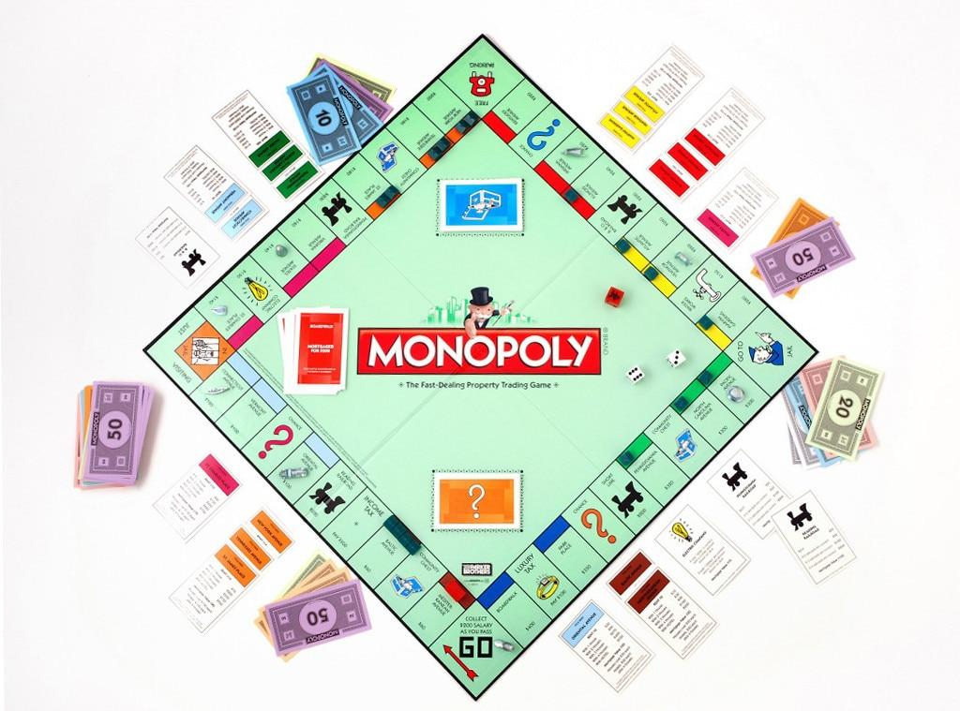
Notes:
Let’s look at an example:
What are some of the mechanics of monopoly?

Slide 27
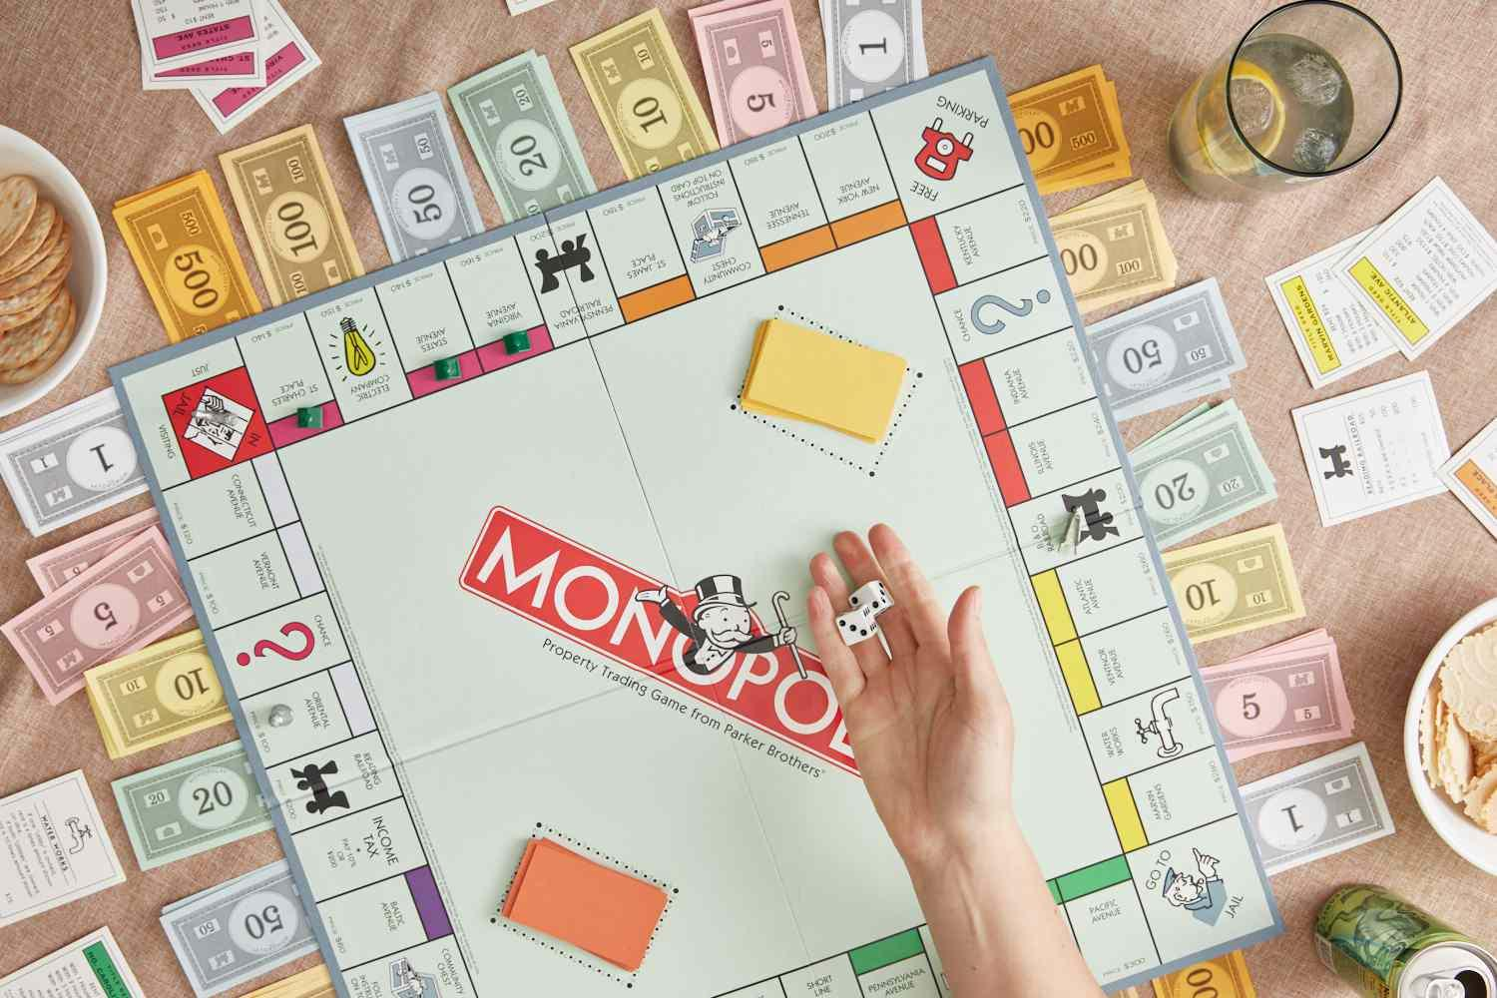

Slide 28
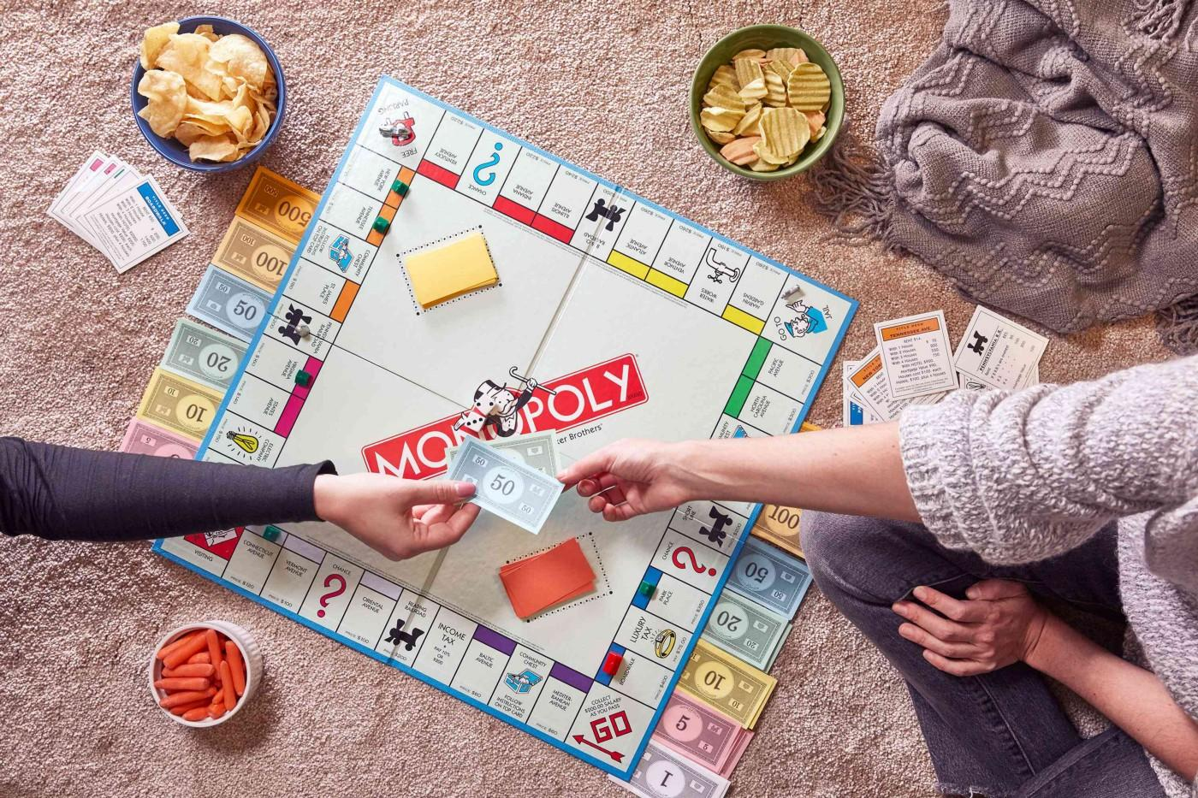

Slide 29
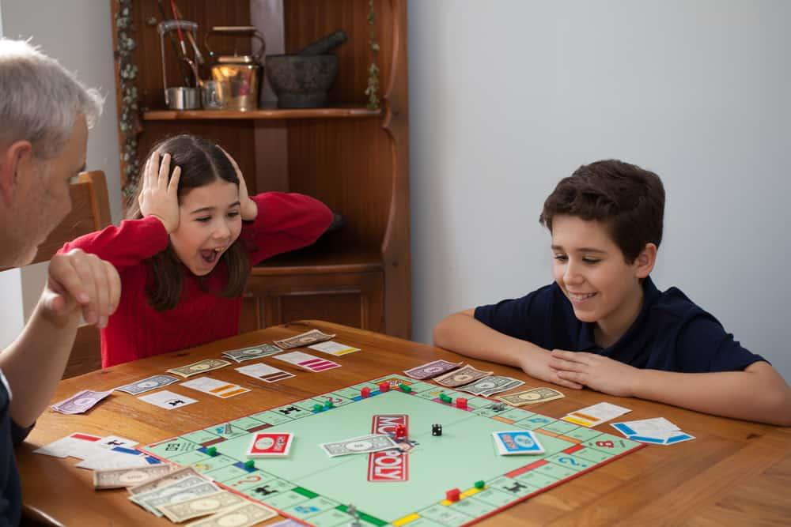

Slide 30
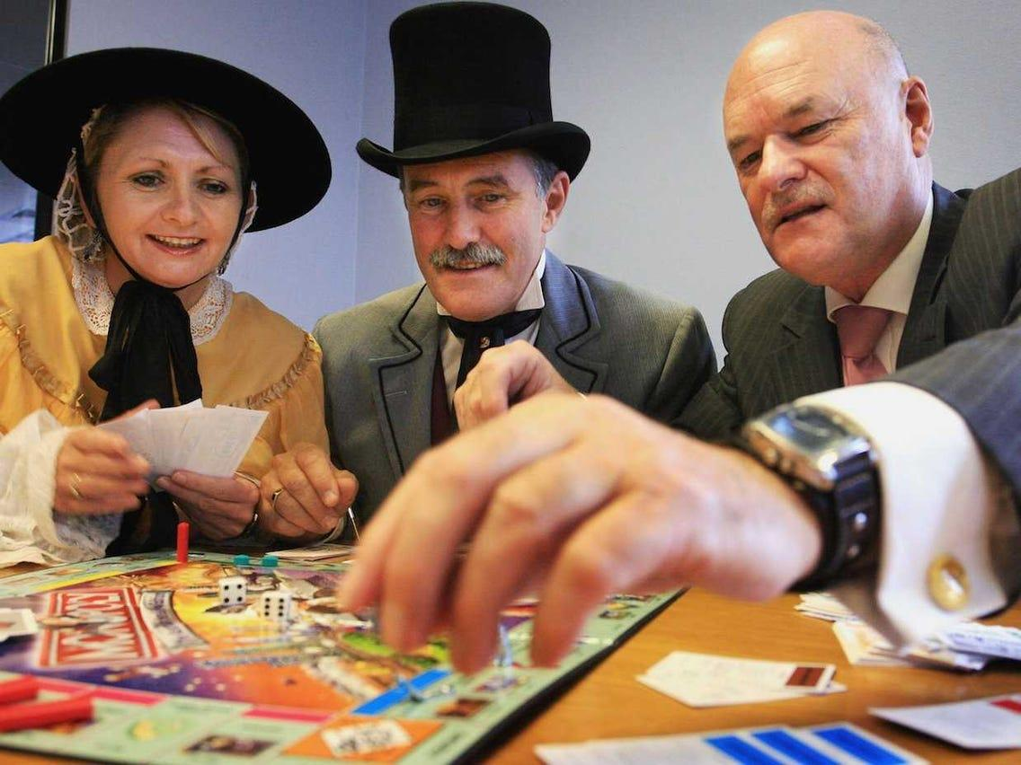

Slide 31
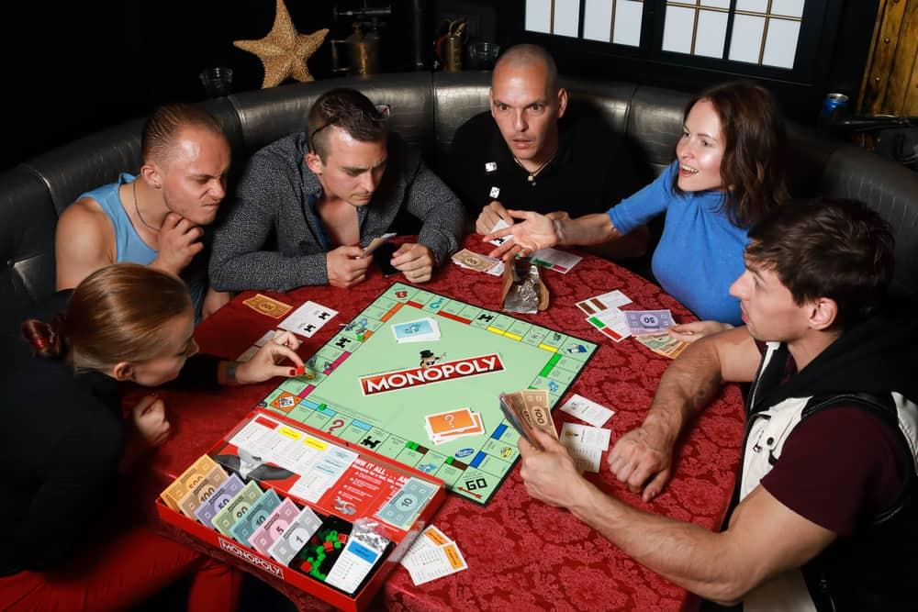

Slide 32
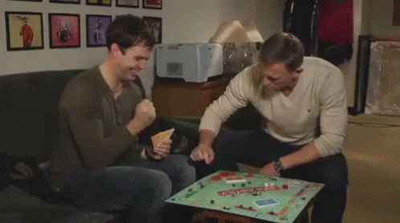

Slide 33
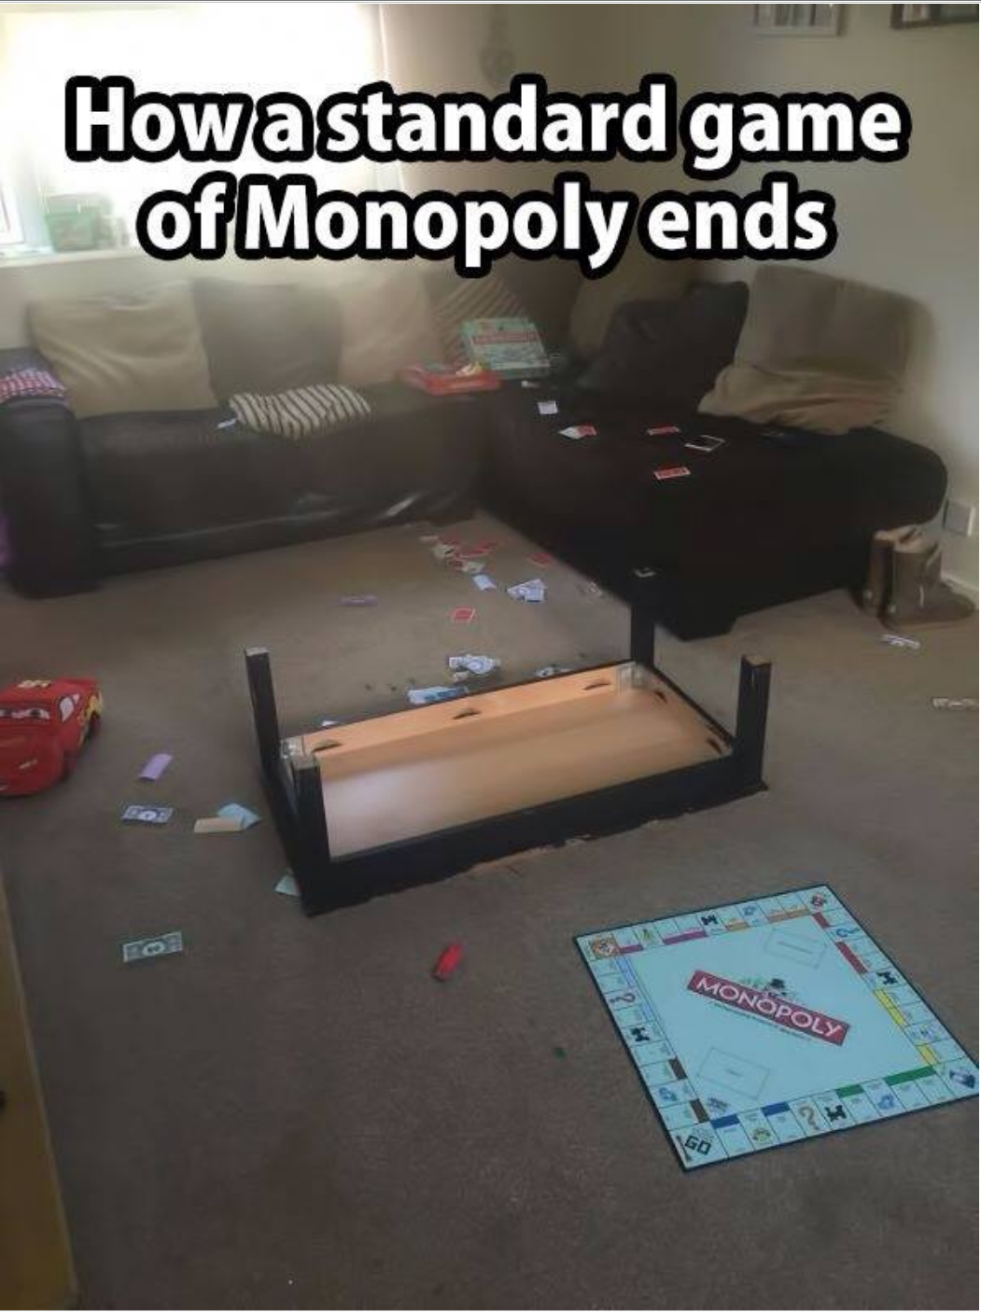

Slide 34
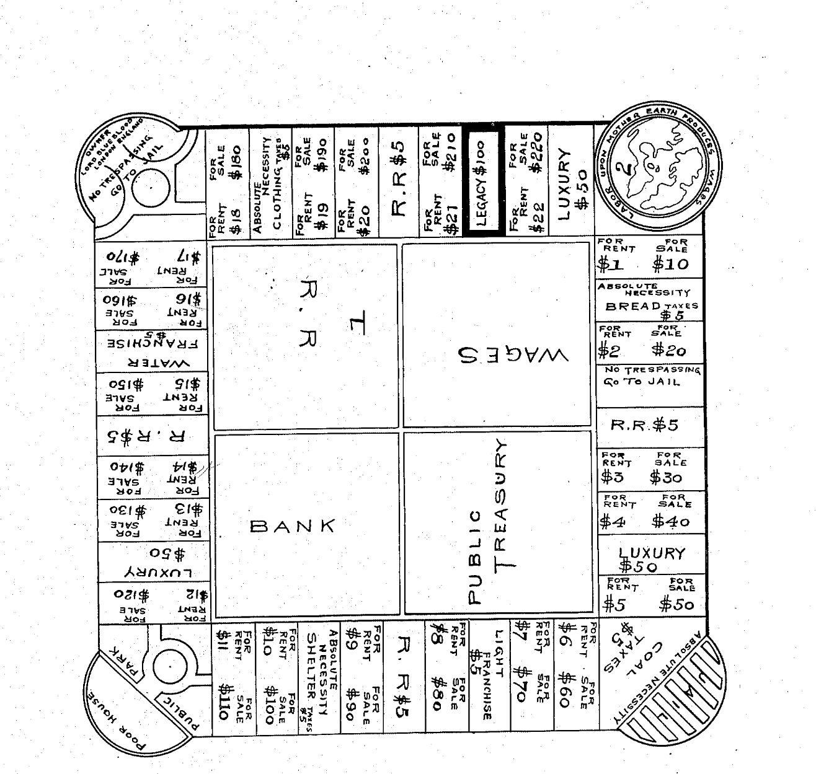
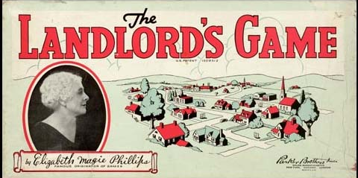
Notes:
The set had rules for two different games, anti-monopolist and Monopolist. The anti-monopolist rules reward all players during wealth creation, whereas the monopolist rules incentivize forming monopolies and forcing opponents out of the game.^{[3]} In the anti-monopolist or Single Tax version (later called "Prosperity"), the game is won when the player with the least money doubles their original stake.
Elizabeth maggie phillips game was stolen by parker brothers

Slide 35
The Iterative Game Design Process
Notes:
~45 Mins in

Slide 36
Game Design Process
Design
Evaluate
Prototype
Playtest

Slide 37
Design
What EMOTIONS do you want players to experience?
What’s the goal or OBJECT of the game?
What is the core activity that players do in a LOOP?
What makes the game END?
Think things up
and write things down!

Slide 38
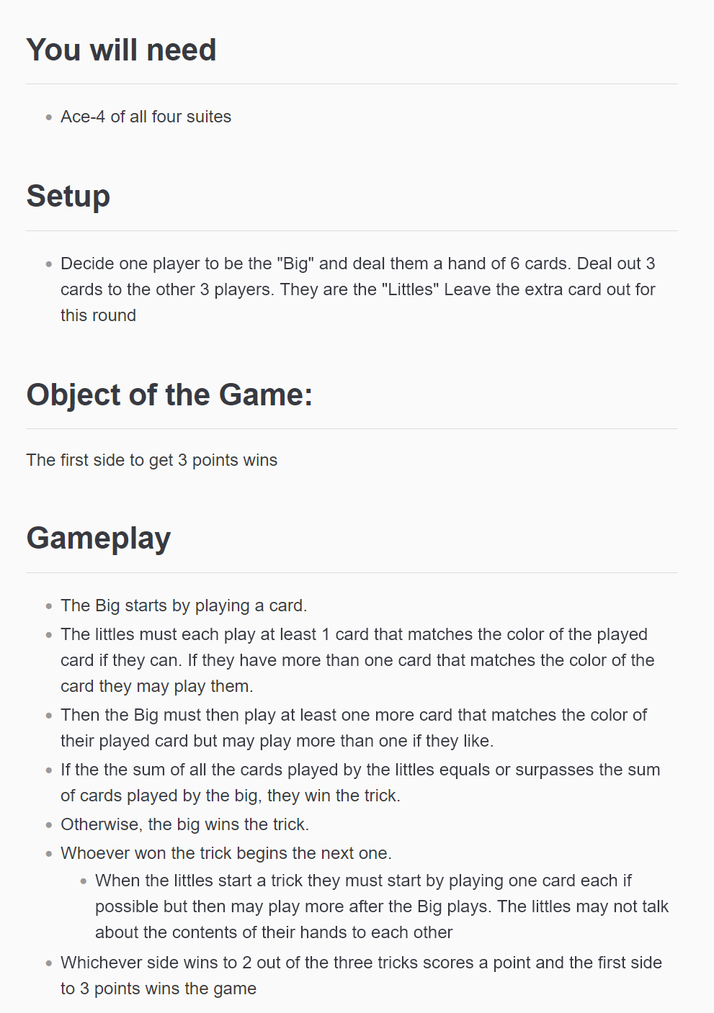
GDD

Slide 39
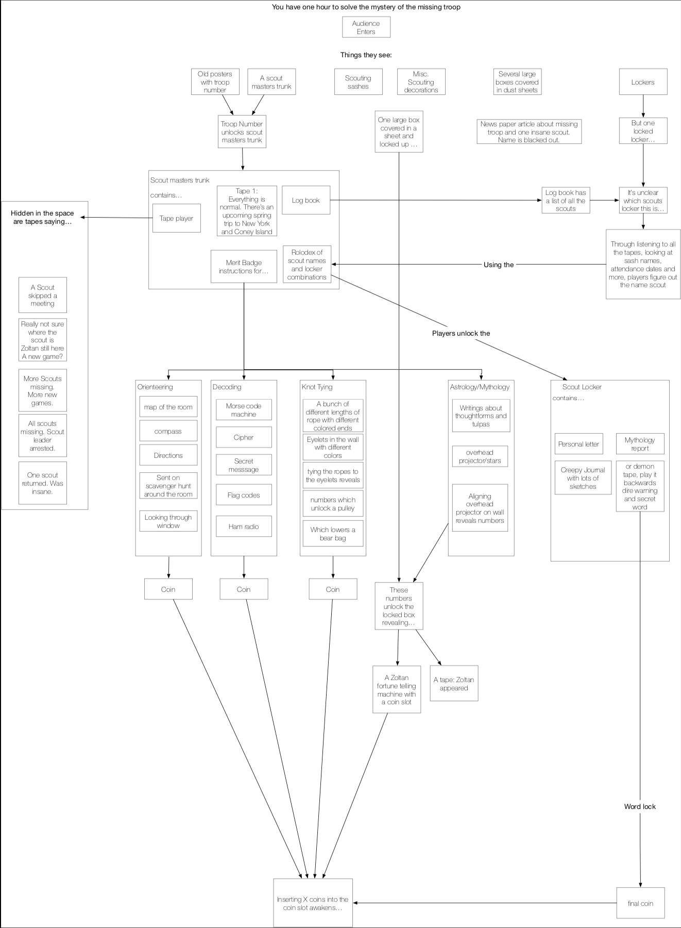
Diagram

Slide 40
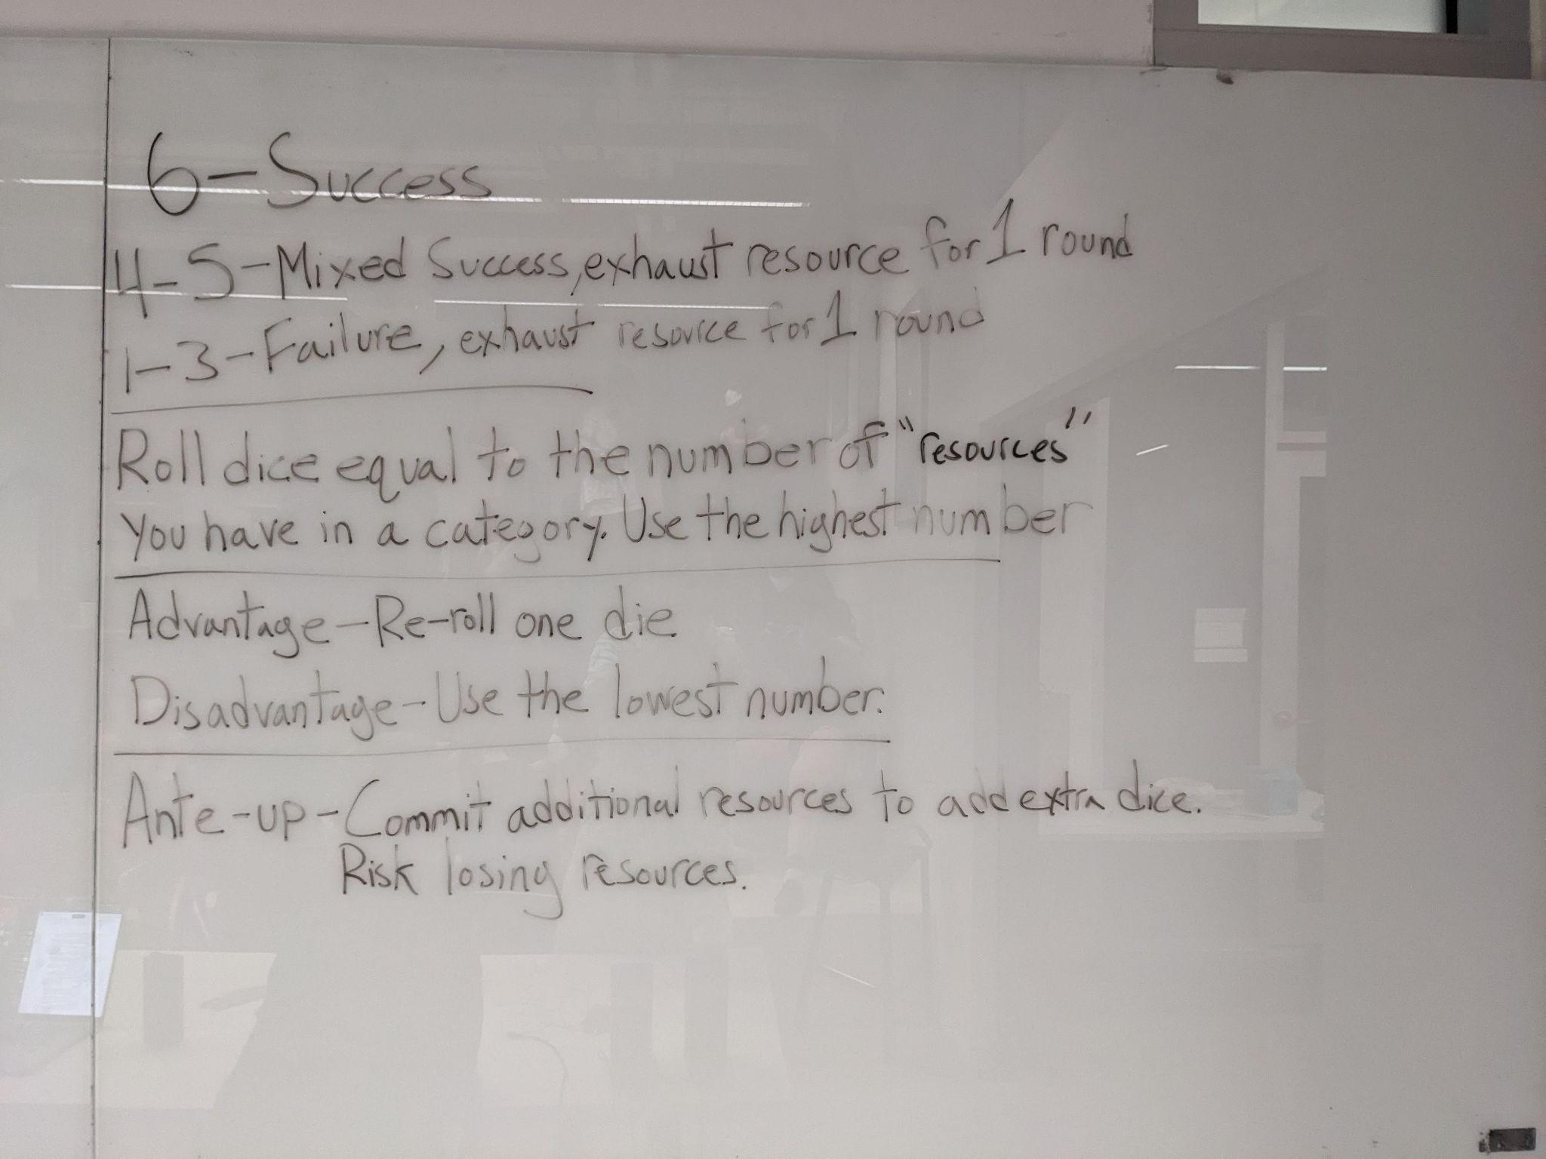
Whiteboard

Slide 41
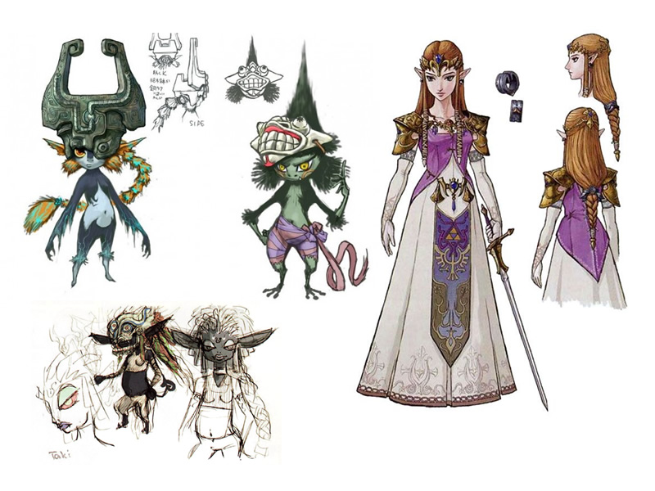
Concept Art

Slide 42
It doesn’t need to be perfect,
just start somewhere.

Slide 43
Prototype
Make a playable prototype AS SOON AS POSSIBLE
Aesthetics and polish DO NOT MATTER
Make the minimum viable product (MVP) needed to test out your idea
Paper is better!

Slide 44
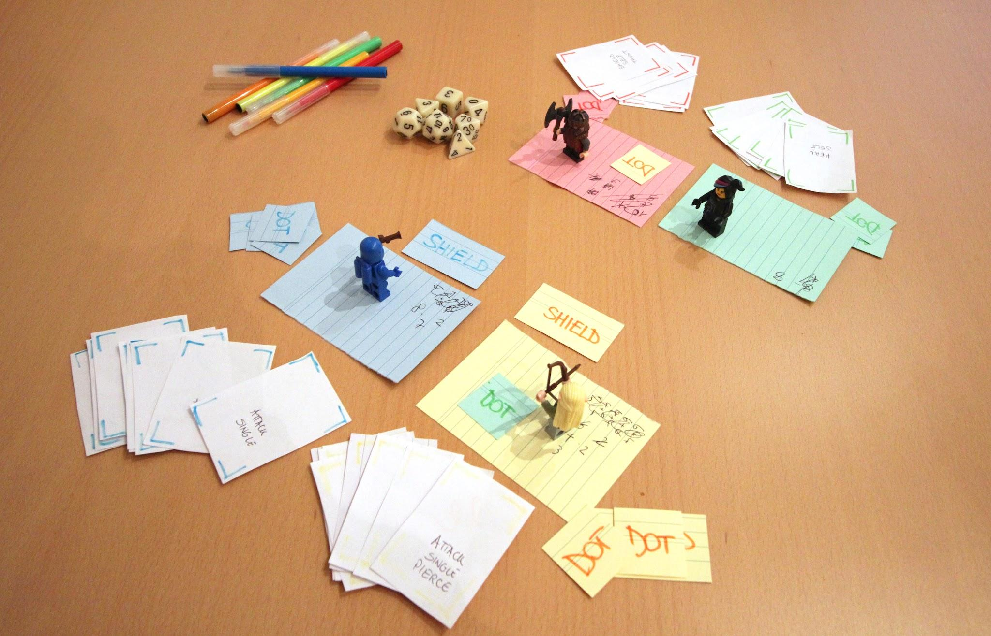

Slide 45
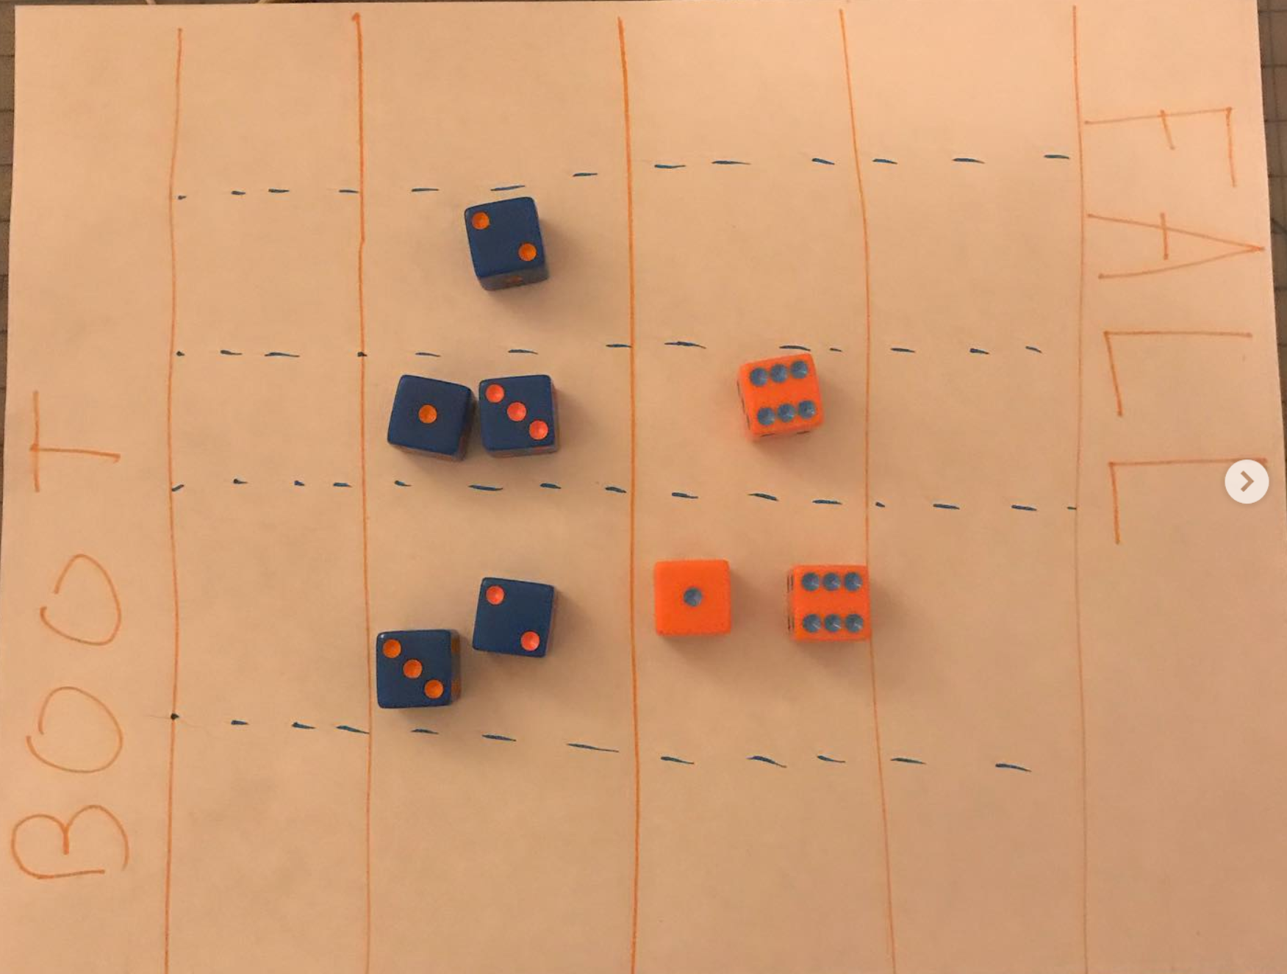

Slide 46
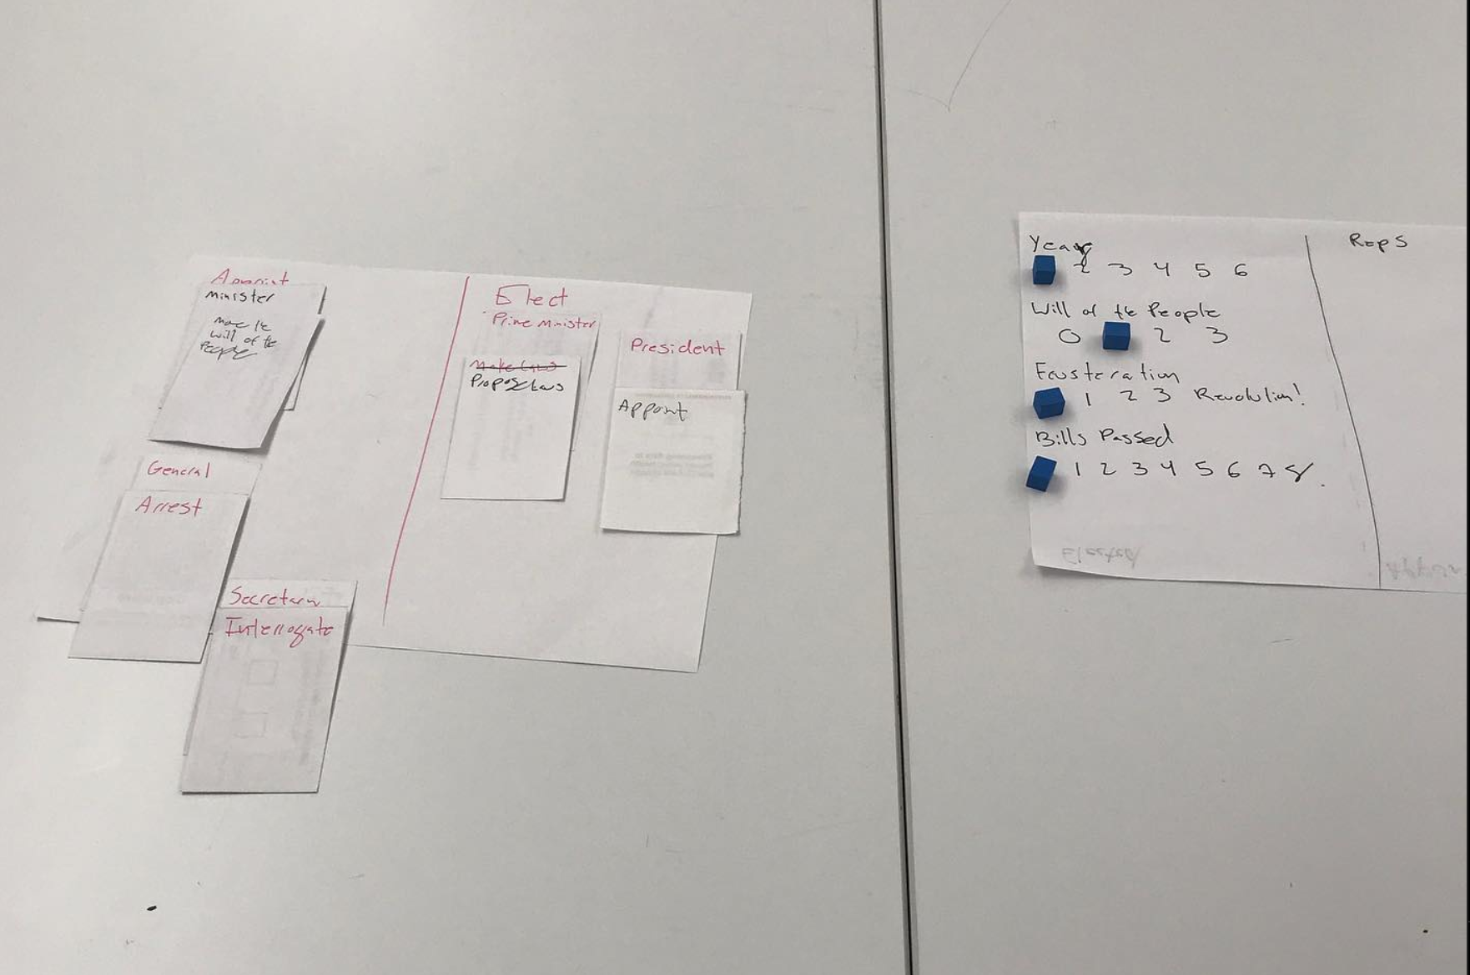

Slide 47
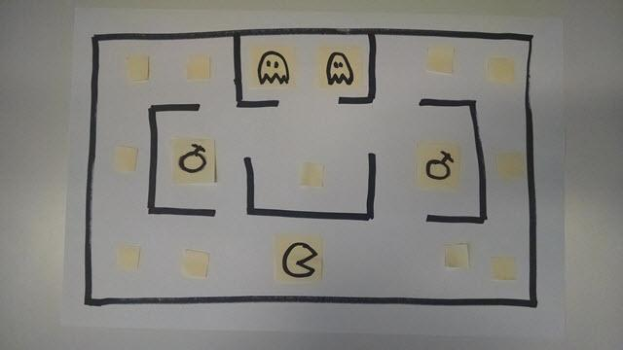

Slide 48
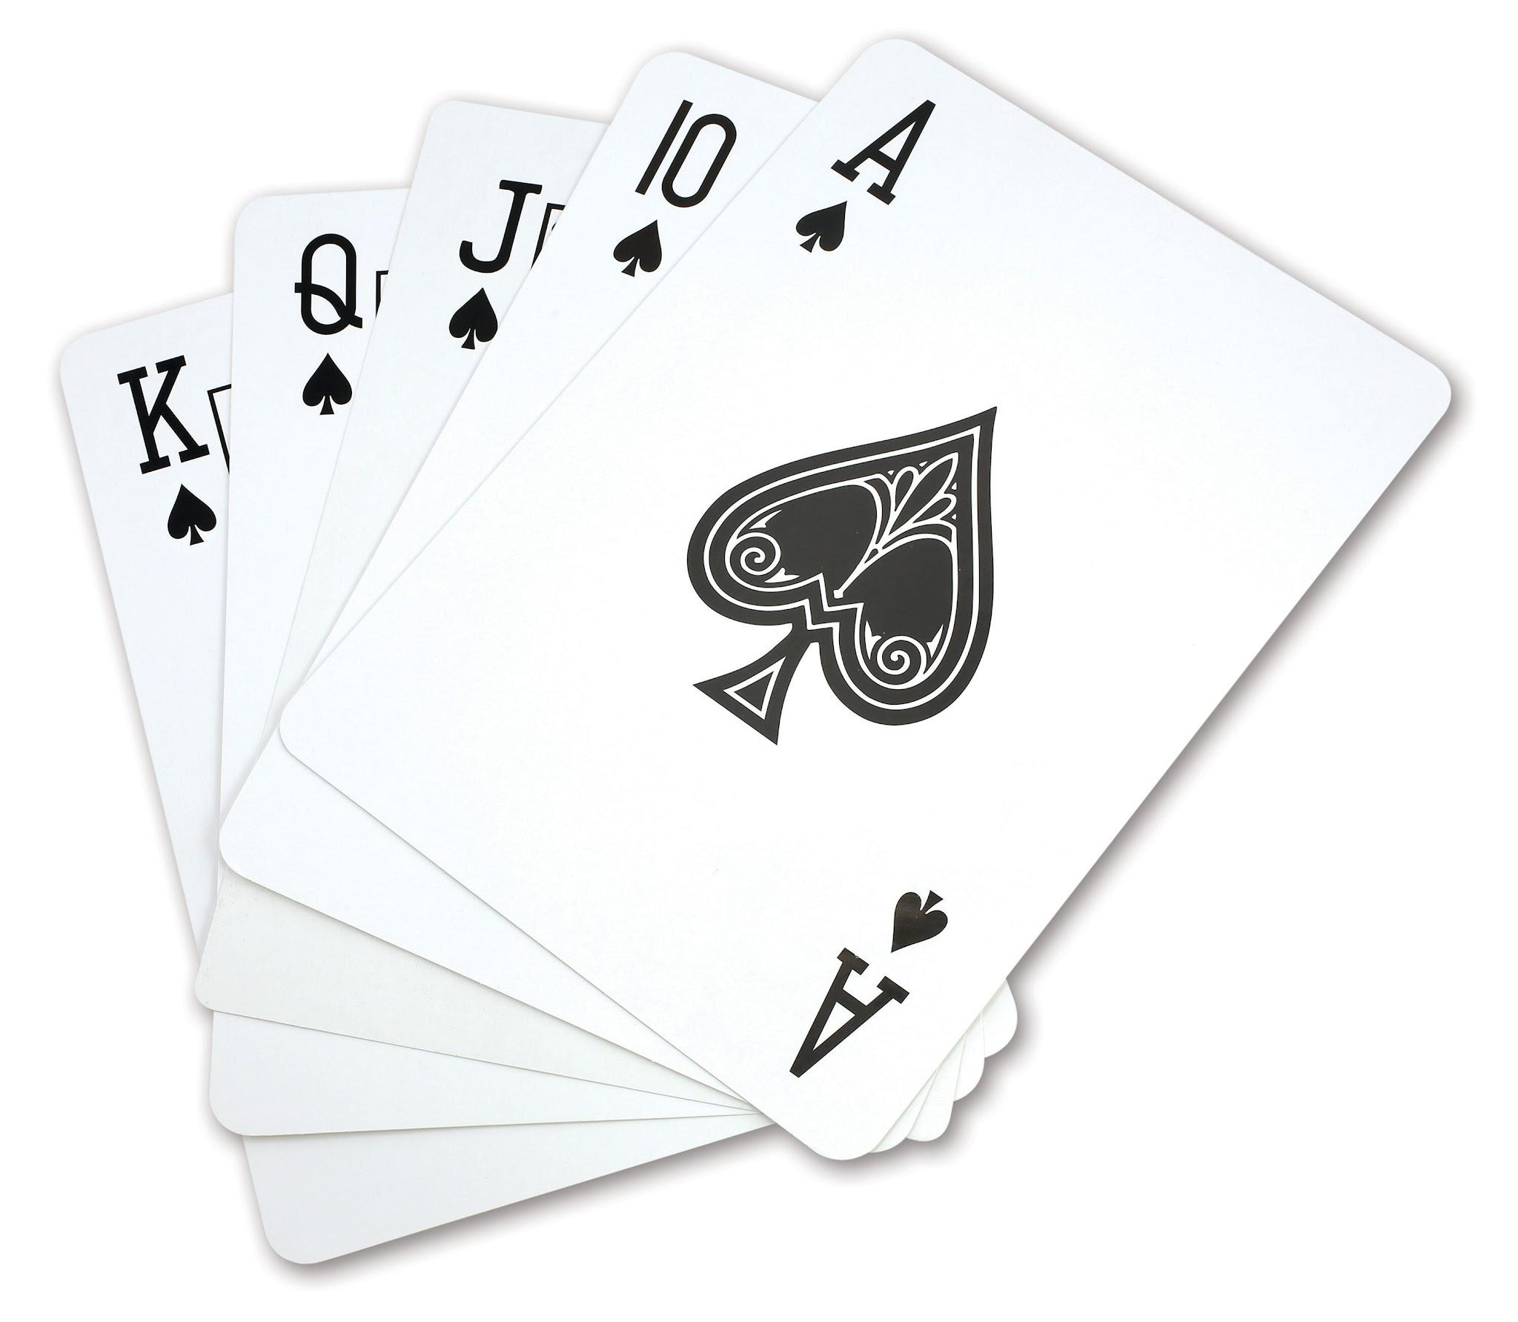

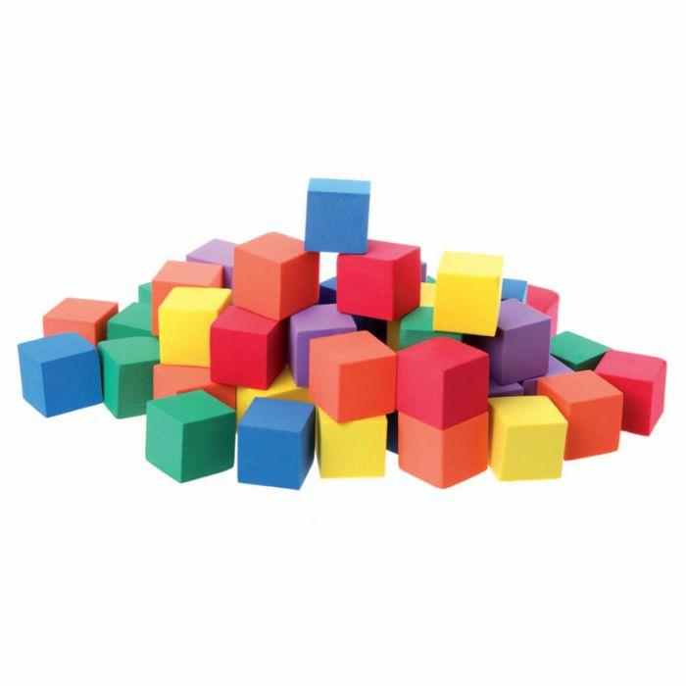
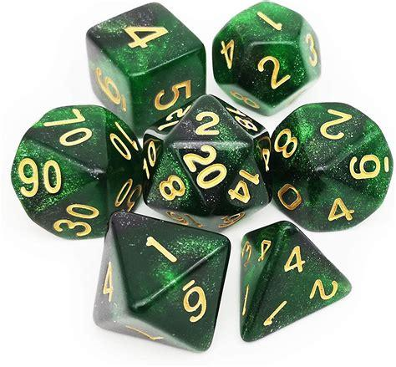
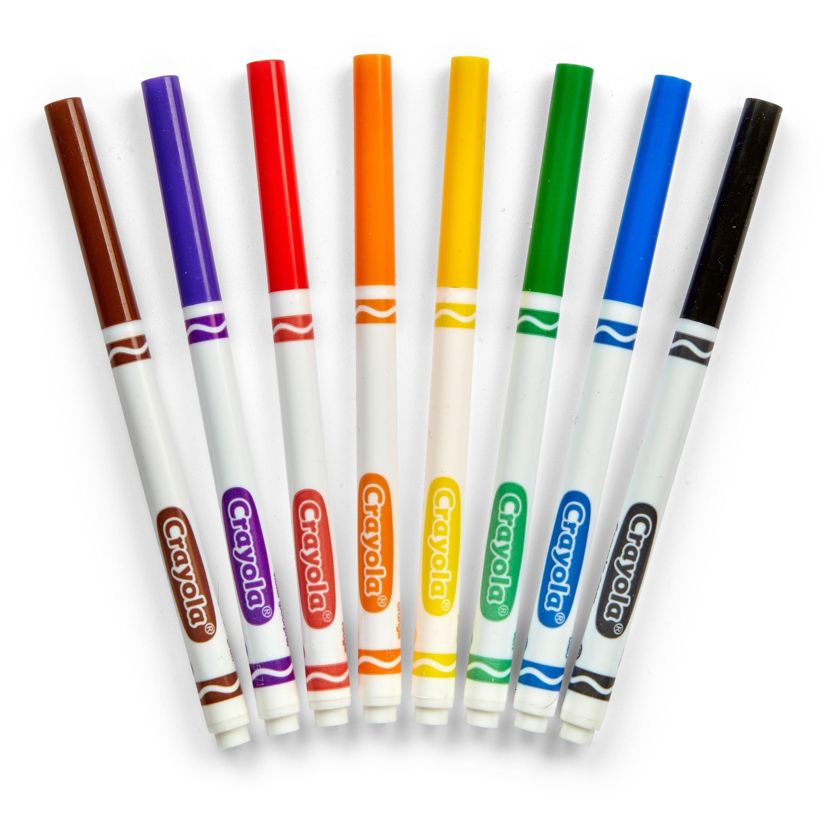
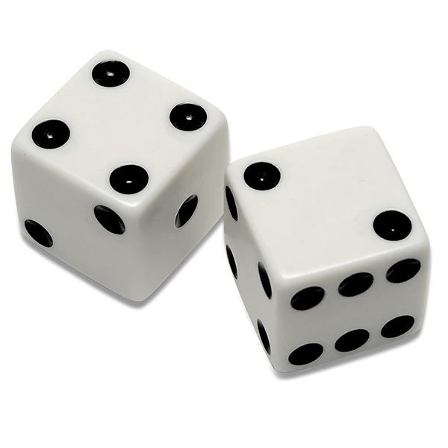
Paper Prototyping BFFs

Slide 49
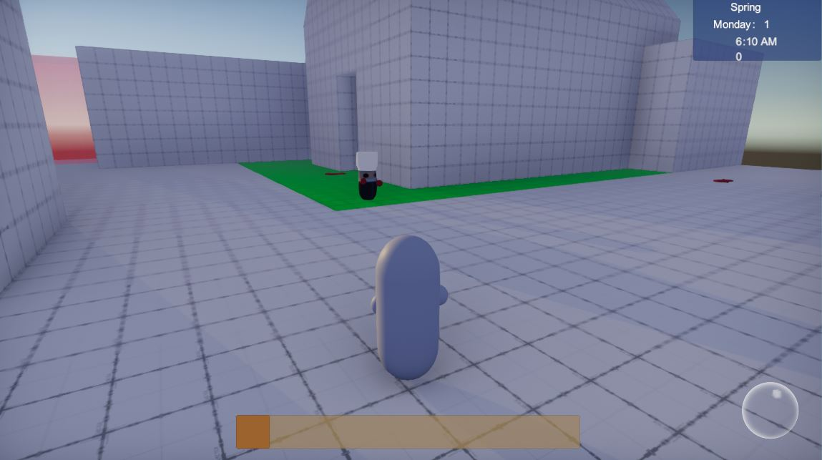
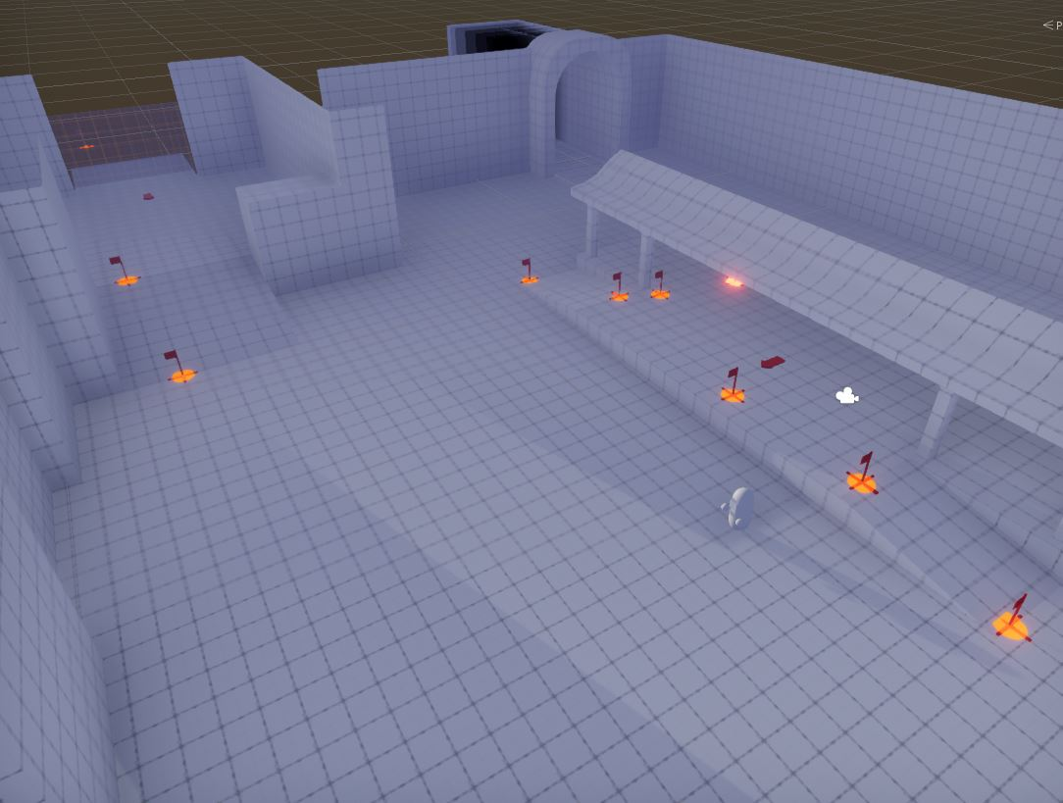
Greyboxing

Slide 50
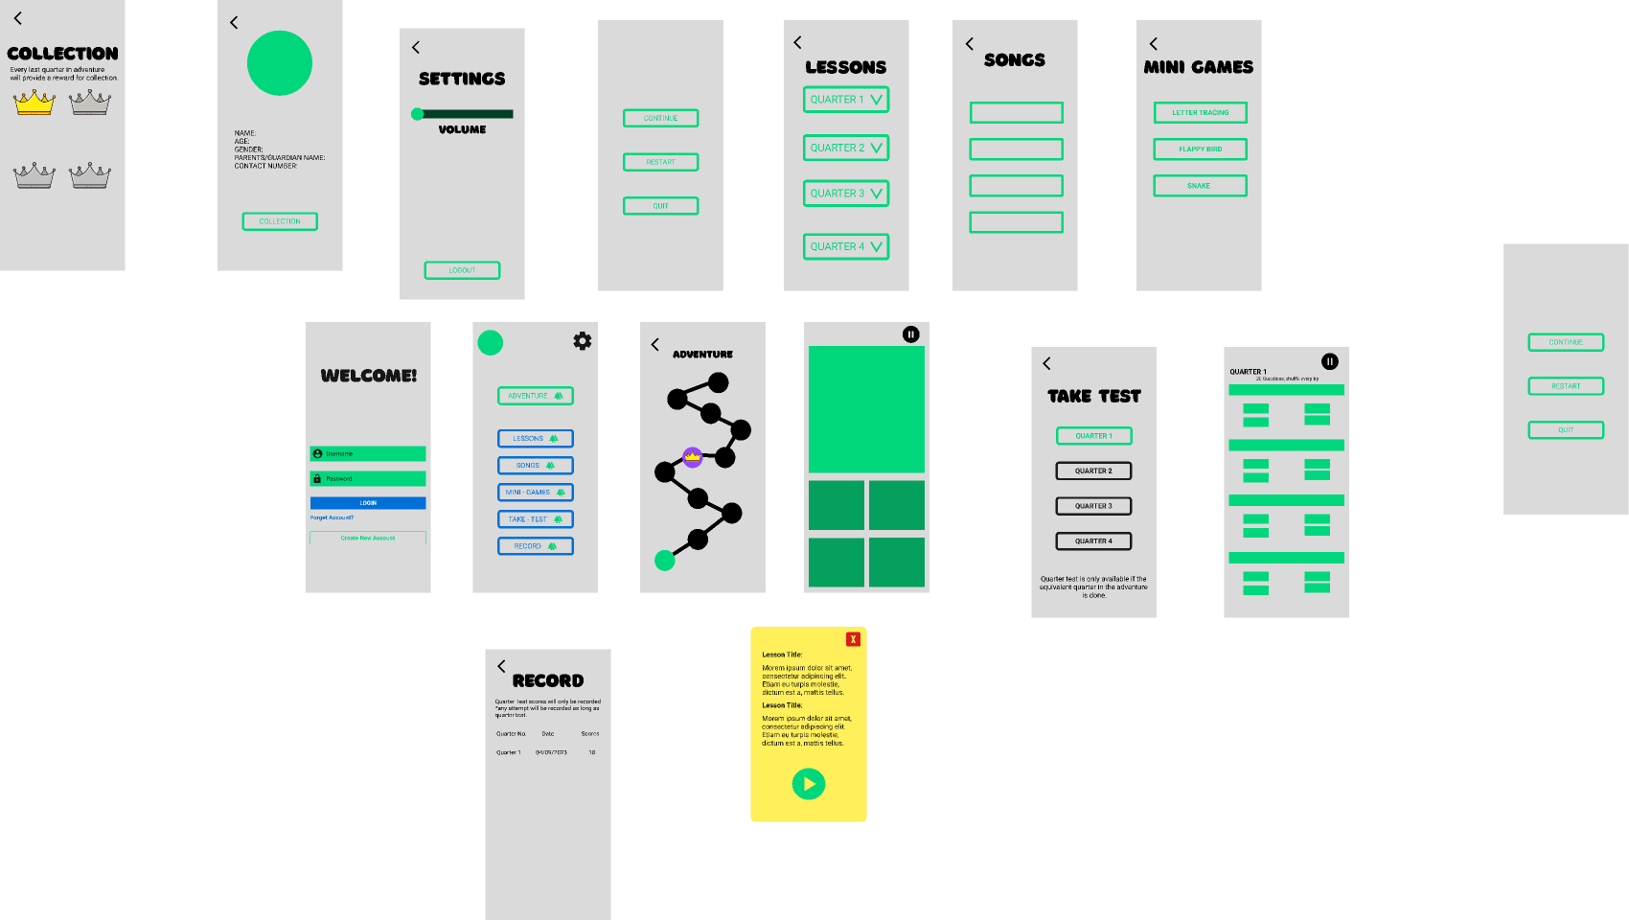
Wireframes

Slide 51
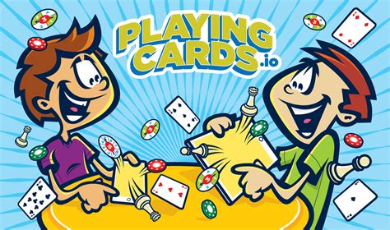
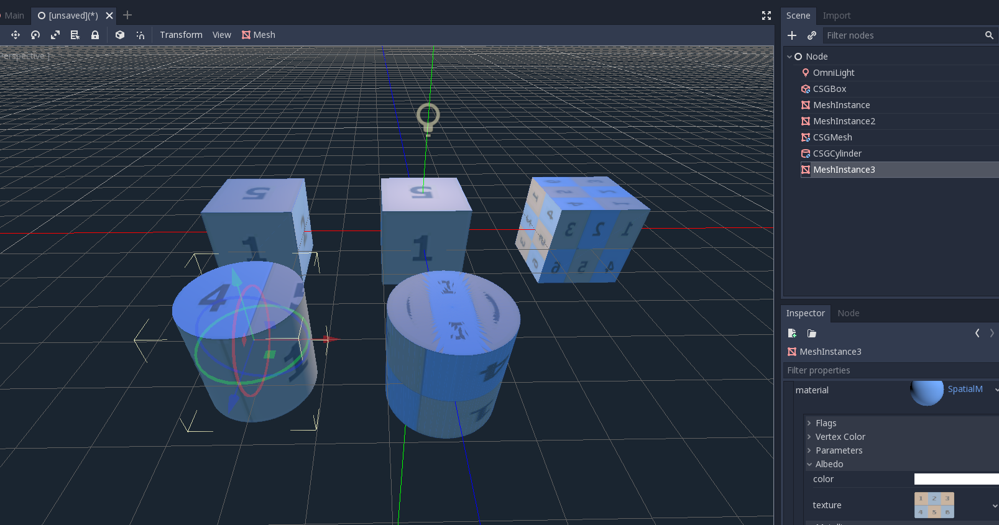
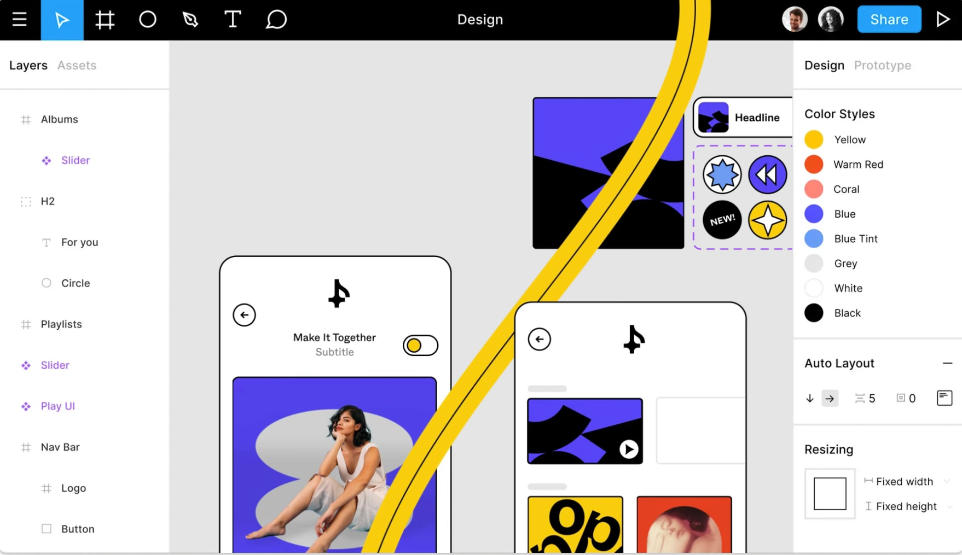




Digital Prototyping BFFs

Slide 52
Playtesting
Try to play the game AS SOON AS POSSIBLE
Play to DISCOVER. You don’t need to know everything in advance.
DON’T CHANGE THE RULES while playing
Notice how the game makes you FEEL
Play the game!

Slide 53
Evaluate
Did the emotions match the intended aesthetics?
What changes could you make to mechanics to create different dynamics?
Were the rules clear? Are there any holes?
How did it go?

Slide 54
Then you start all over again!

Slide 55
Game Design Process
Design
Evaluate
Prototype
Playtest

Slide 56

Game Design Process
Design
Evaluate
Prototype
Playtest

Slide 57
Can I get a job as a game designer?

Slide 58
YES!

Slide 59


Slide 60
AAA
Big fancy game studios

Slide 61







Example AA Games

Slide 62


Slide 63
Indie

Slide 64







Famous Indie Games

Slide 65
It’s a spectrum
Indie
AAA
A bunch of things

Slide 66
There are MANY places to make games
Serious Games
Educational Games
Simulations
Games as Training
Games as advertising
Museums
Mobile Games

Slide 67


Slide 68
How can I become a game designer?

Slide 69
Make a game!
Notes:
Game design is a highly competitive field, but the barrier to entry is really low.
You don’t need to wait for anyone to tell you you’re allowed to do it.
With foss software and plenty of info on the internet you can just start
Being a game designer is just being a person who designs games

Slide 70
Specifically you could…
Download a game engine
Join a game jam
Watch a couple of youtube videos
Read a book
Or……..

Slide 71
TAKE MY CLASS!!!
Intro to Game Design

Slide 72
More about me
I make stuff

Slide 73
Wrap up
Thanks!

